Slide 1
SFA experimentation on Zañudo 2015

Slide 2
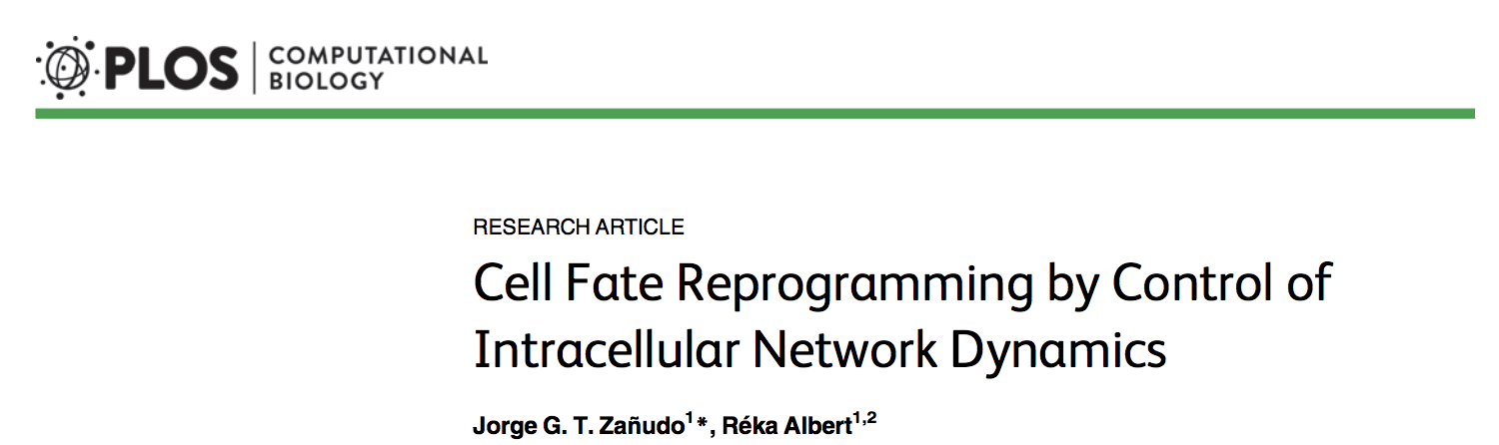
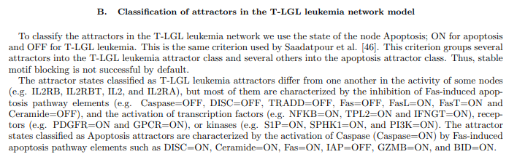
Classification of Phenotypes
T-LGL leukemia attractors
OFF: Caspase, DISC, TRADD, Fas,Ceramide, Apoptosis
ON: FasL, FasT,
TFs: NFKB, TPL2, IFNGT
or
receptors: PDGFR, GPCR
or
kinases: S1P,SPHK1,PI3K
Apoptosis attractors
OFF: IAP
ON: Caspase, DISC, Ceramide, Fas, GZMB, BID, Apoptosis

Slide 3
Objective: Determine if SFA can be used to predict phenotypes
Exploration 1: Compare direction of activity change of SFA attractors to BoolNet attractors
Exploration 2: Cluster randomly simulated attractors with kmeans

Slide 4
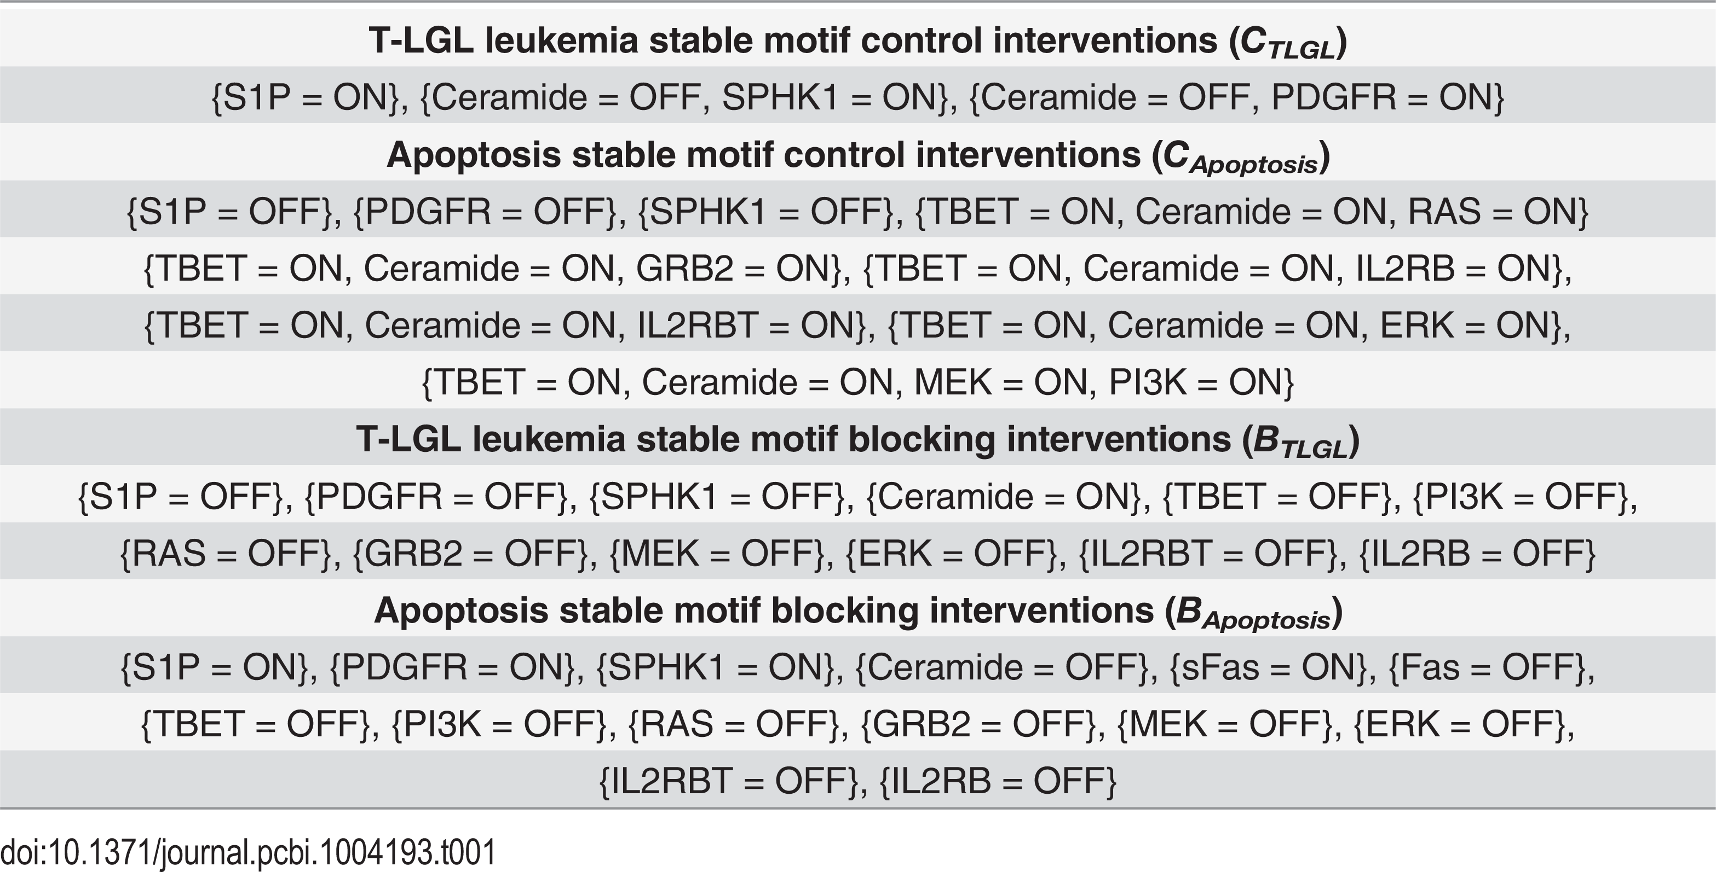
Simulate Leukemia and Apoptosis attractors with BoolNet
2 Leukemia attractors (L1 and L2)
6 Apoptosis attractors (Ai for i = 1,….6)
Each apoptosis attractor was the same but reached by fixing different nodes so they have different basins of attraction

Slide 5
Boolean Model
Static Network
6
7
6
7
4
4
10
10
9
9
2
5
2
5
1
1
8
8
3
3
A
A
L
L
A
Leukemia
Apoptosis
L
A
A
L
A
Initial State
Intermediate State
Attractor

Slide 6
Simulate Leukemia and Apoptosis attractors with SFA
Took the partial basin of attraction for the 6 attractors identified in BoolNet and simulated the trajectory with sfa, fixing the same nodes as we did with BoolNet
73 Apoptosis attractors (69 unique)
10 from “basin” of A1
11 from “basin” of A2
13 from “basin” of A3
14 from “basin” of A4
15 from “basin” of A5
10 from “basin” of A6
36 Leukemia attractors
19 from “basin” of L1
17 from “basin” of L2
Notation:
Each attractor produced by signal flow is labelled as:
Ai.j or Ln.m
Where i (n) is the attractor number of the Apoptosis (Leukemia) boolnet attractor and j (m) is the state in the “basin” of attractor i (n)

Slide 7
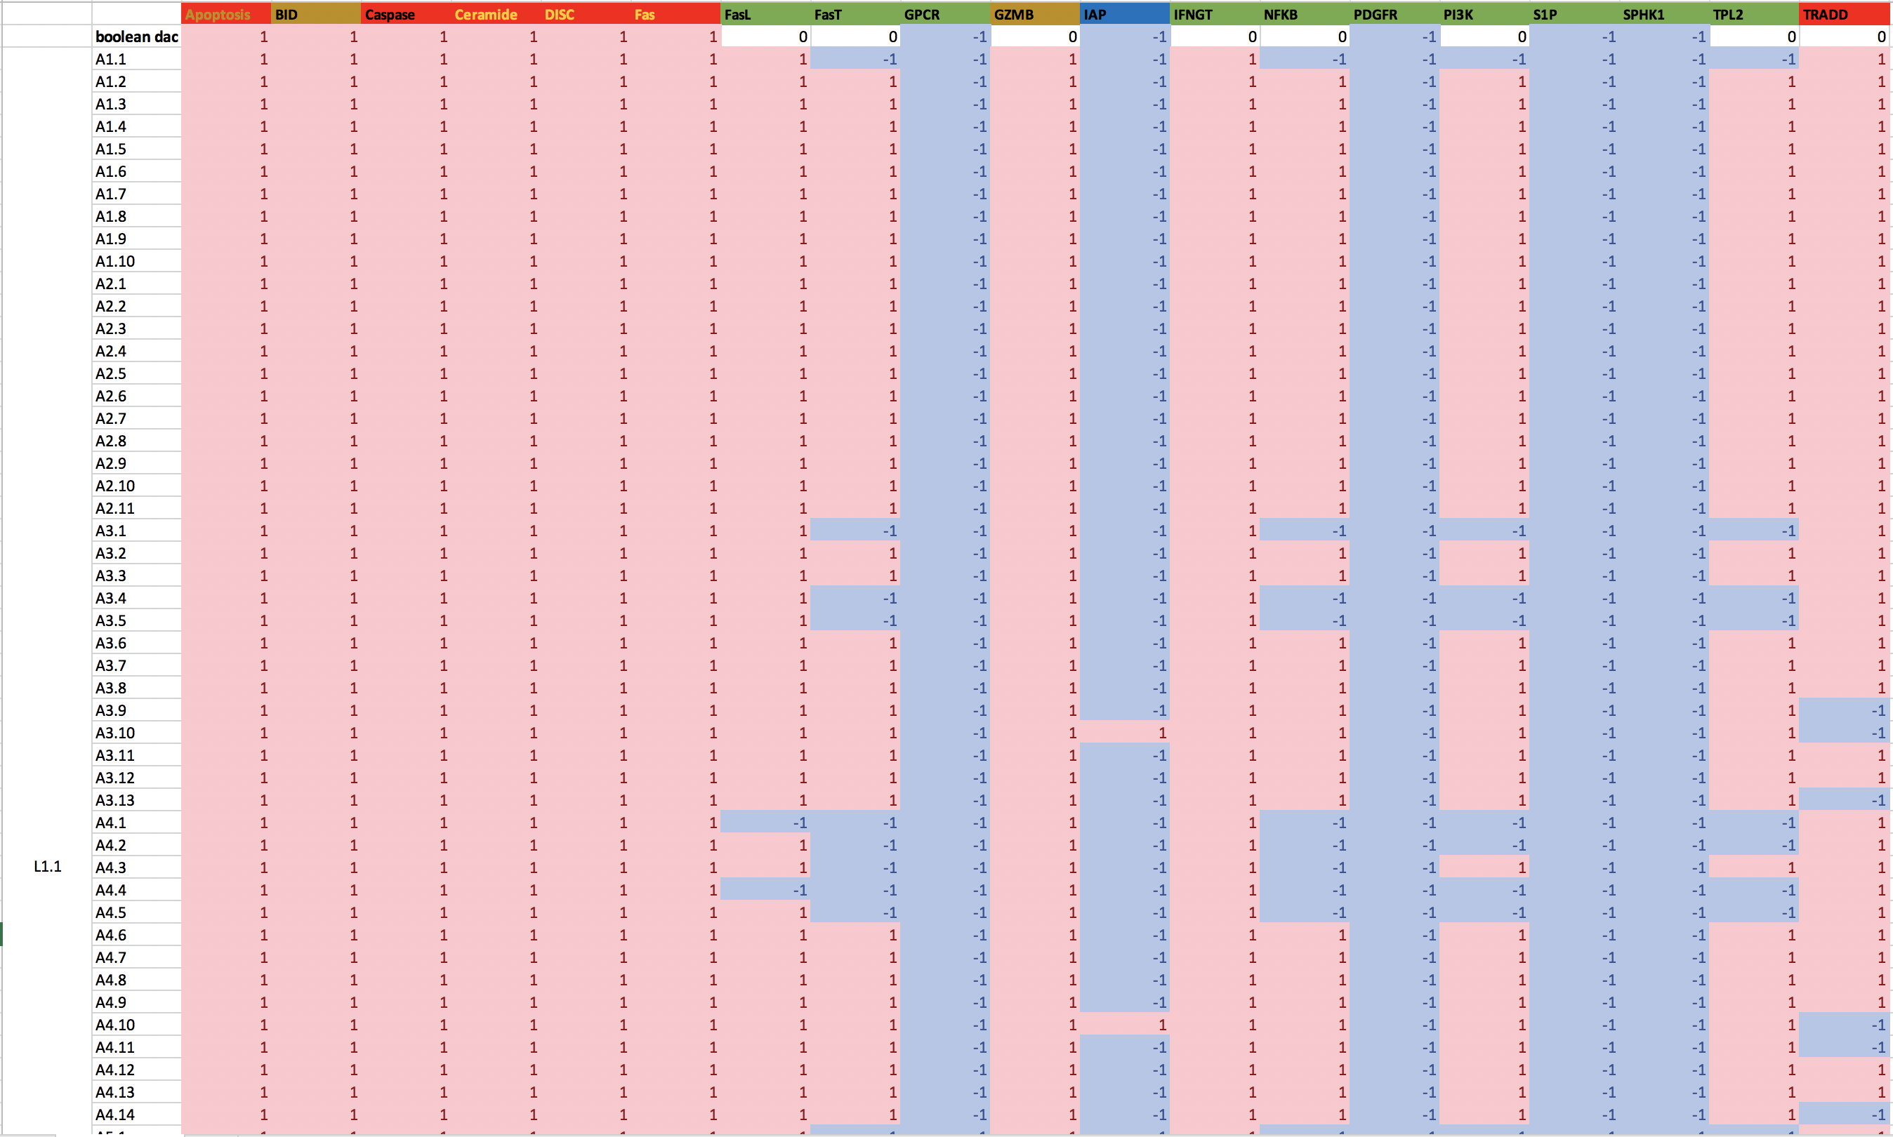
DAC of Readout Nodes (RONs) Ai.j – L1.m
OFF in Leukemia
ON in Leukemia
OFF in Apoptosis
ON in Apoptosis
OFF in leukemia, ON in apoptosis

Slide 8
Hamming Distance
We calculated the hamming distance between the DAC of the readout nodes (RONs) of each SFA attractor and the DAC of the RONs of the BoolNet Leukemia and Apoptosis attractors
Ai.j Vs L1.m DAC
98% of the SFA attractors were 57% accurate.
2% of the SFA attractors were 52% accurate.
98% of the SFA attractors were 100% accurate.
2% of the SFA attractors were 91% accurate.
Ai.j Vs L2.m DAC
94% of the SFA attractors were 57% accurate.
6% of the SFA attractors were 52% accurate.
94% of the SFA attractors were 100% accurate.
6% of the SFA attractors were 91% accurate.
*** When excluding RONs with a DAC of 0 between the Boolean attractors: ***

Slide 9
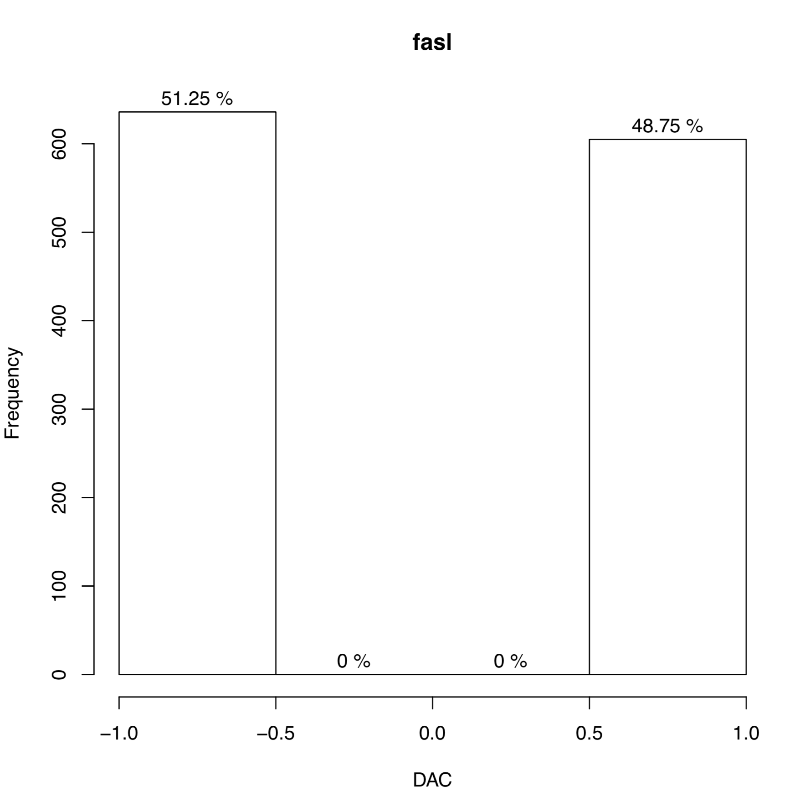
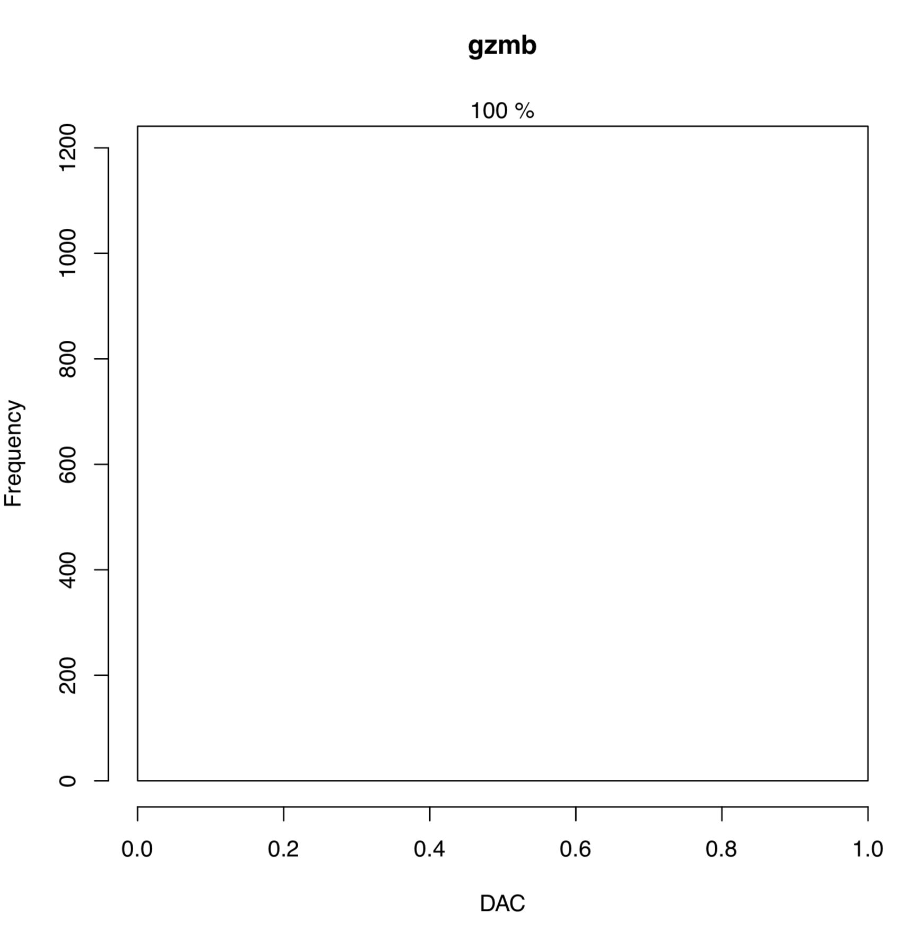
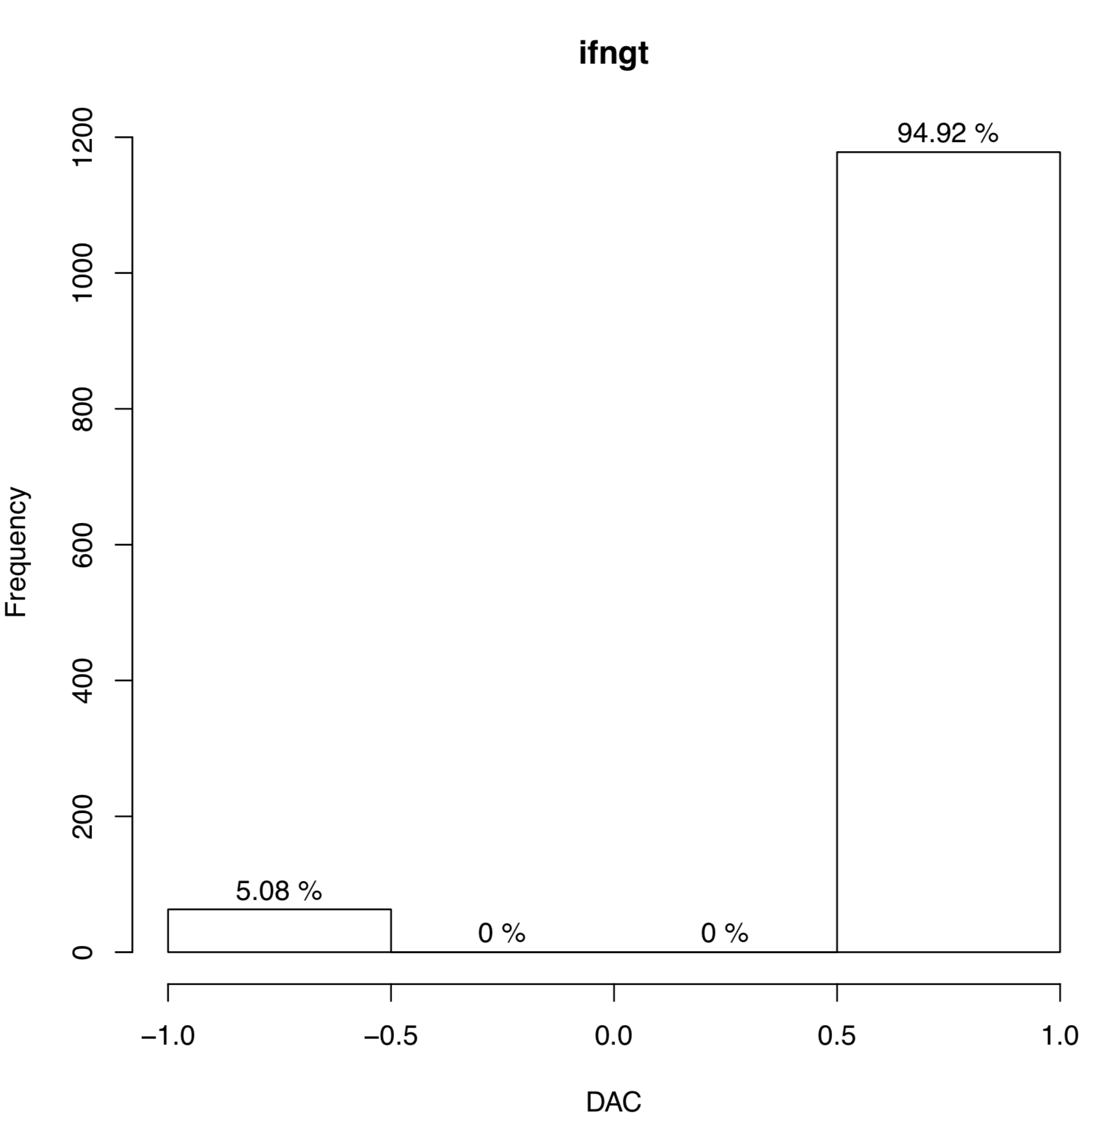
Distribution of SFA DAC for RONs that should have a DAC of 0
My intuition was wrong (see pdf)

Slide 10
Tolerance Exploration with SFA results from Fixed Nodes

Slide 11
Boolean Attractor Landscape
We simulated the attractor landscape of the Boolean network with 100,000 random initial conditions (no fixed nodes)
Resulted in 877 attractors
I classified the attractors based off the readout nodes that do not have a DAC of 0 between the leukemia and apoptosis attractors (see above)
31 Leukemia Attractors (3.5%)
133 Apoptosis Attractors (15.2%)
713 “Other” Attractors (81.3%)

Slide 12
SFA “Attractor Landscape”
We ran SFA with the same 100,000 initializations from BoolNet (no fixed nodes)
Previously Classified the attractors using DAC of RONs without 0 DAC between the Boolean attractors
Decided this was wrong because we were just choosing an arbitrary condition to compare to

Slide 13
SFA “Attractor Landscape”
We ran SFA with the same 100,000 initializations from BoolNet (no fixed nodes)
Previously Classified the attractors using DAC of RONs without 0 DAC between the Boolean attractors
Decided this was wrong because we were just choosing an arbitrary condition to compare to
Compared to median value for Leukemia sfa attractors
1108 leukemia attractors (11%)
3393 apoptosis attractors (34%)

Slide 14
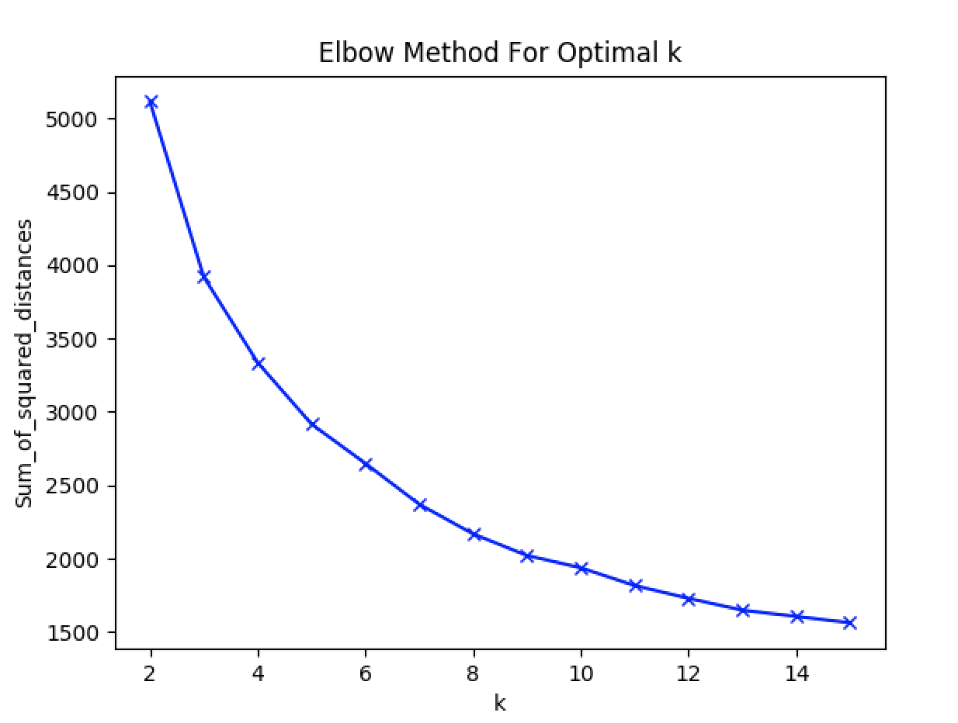
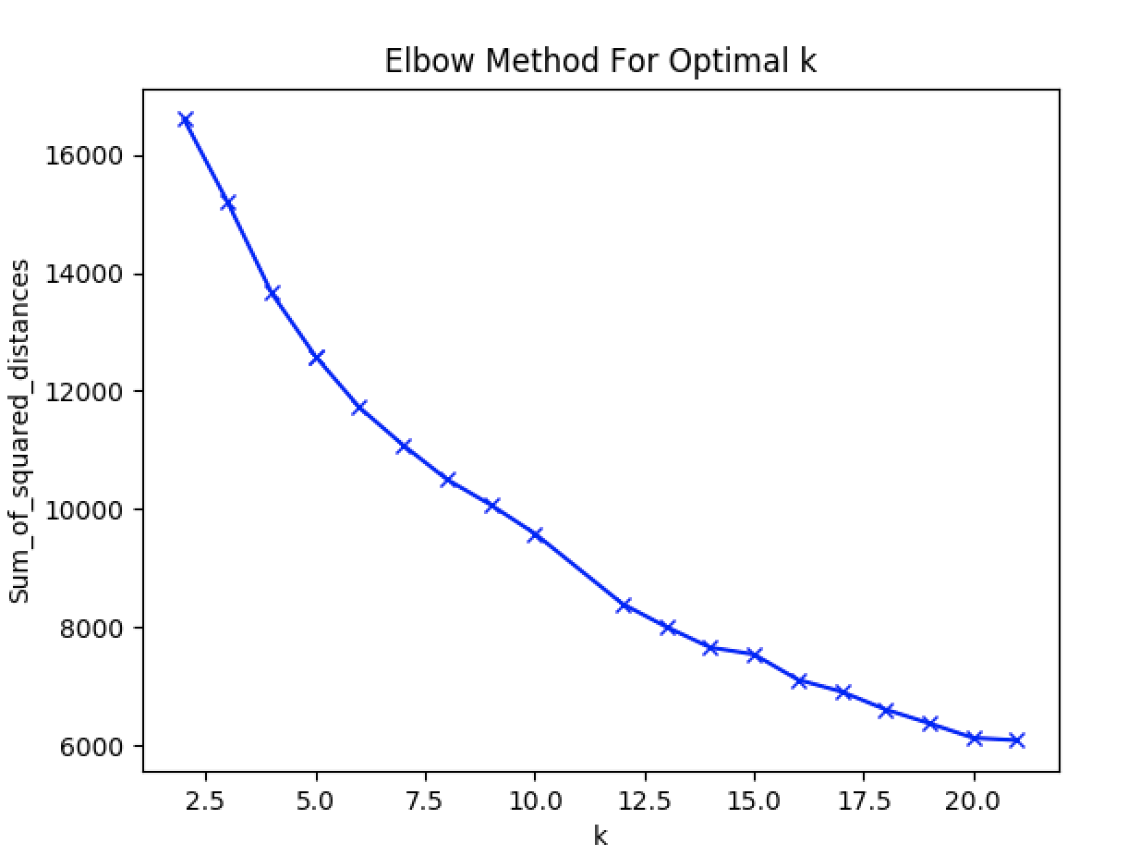
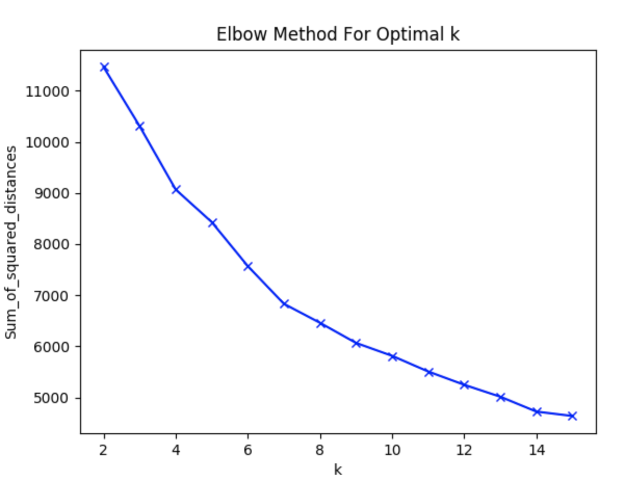
Kmeans - Boolean
Attr
K = 9
Both
K = 14
DAC
K = 7

Slide 15
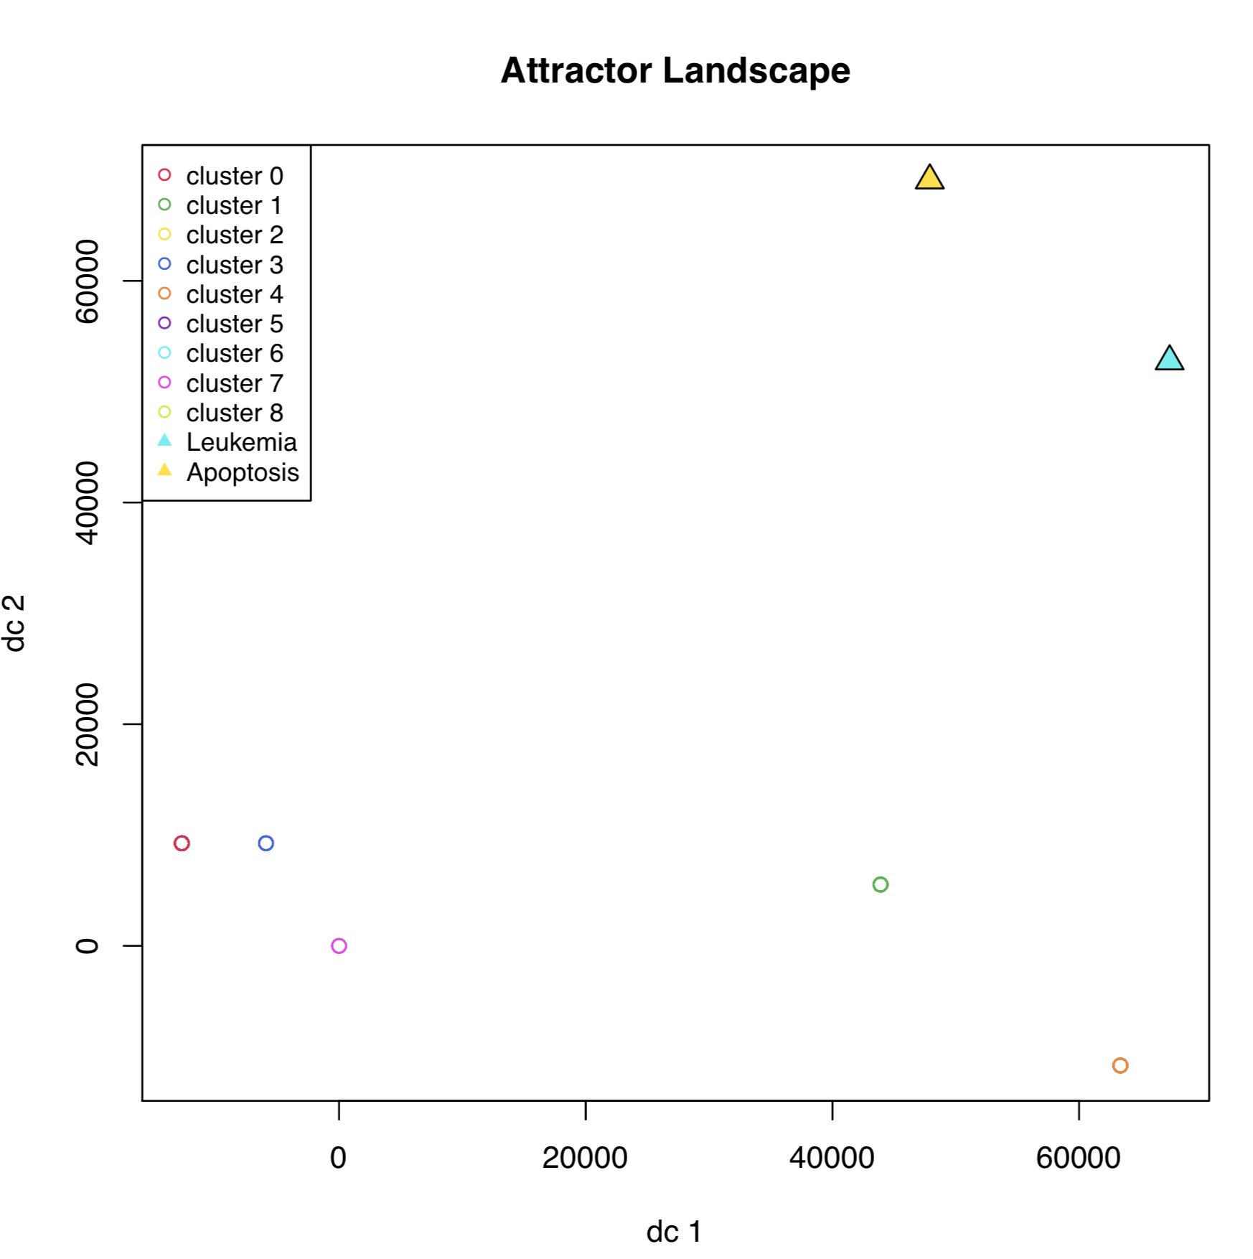
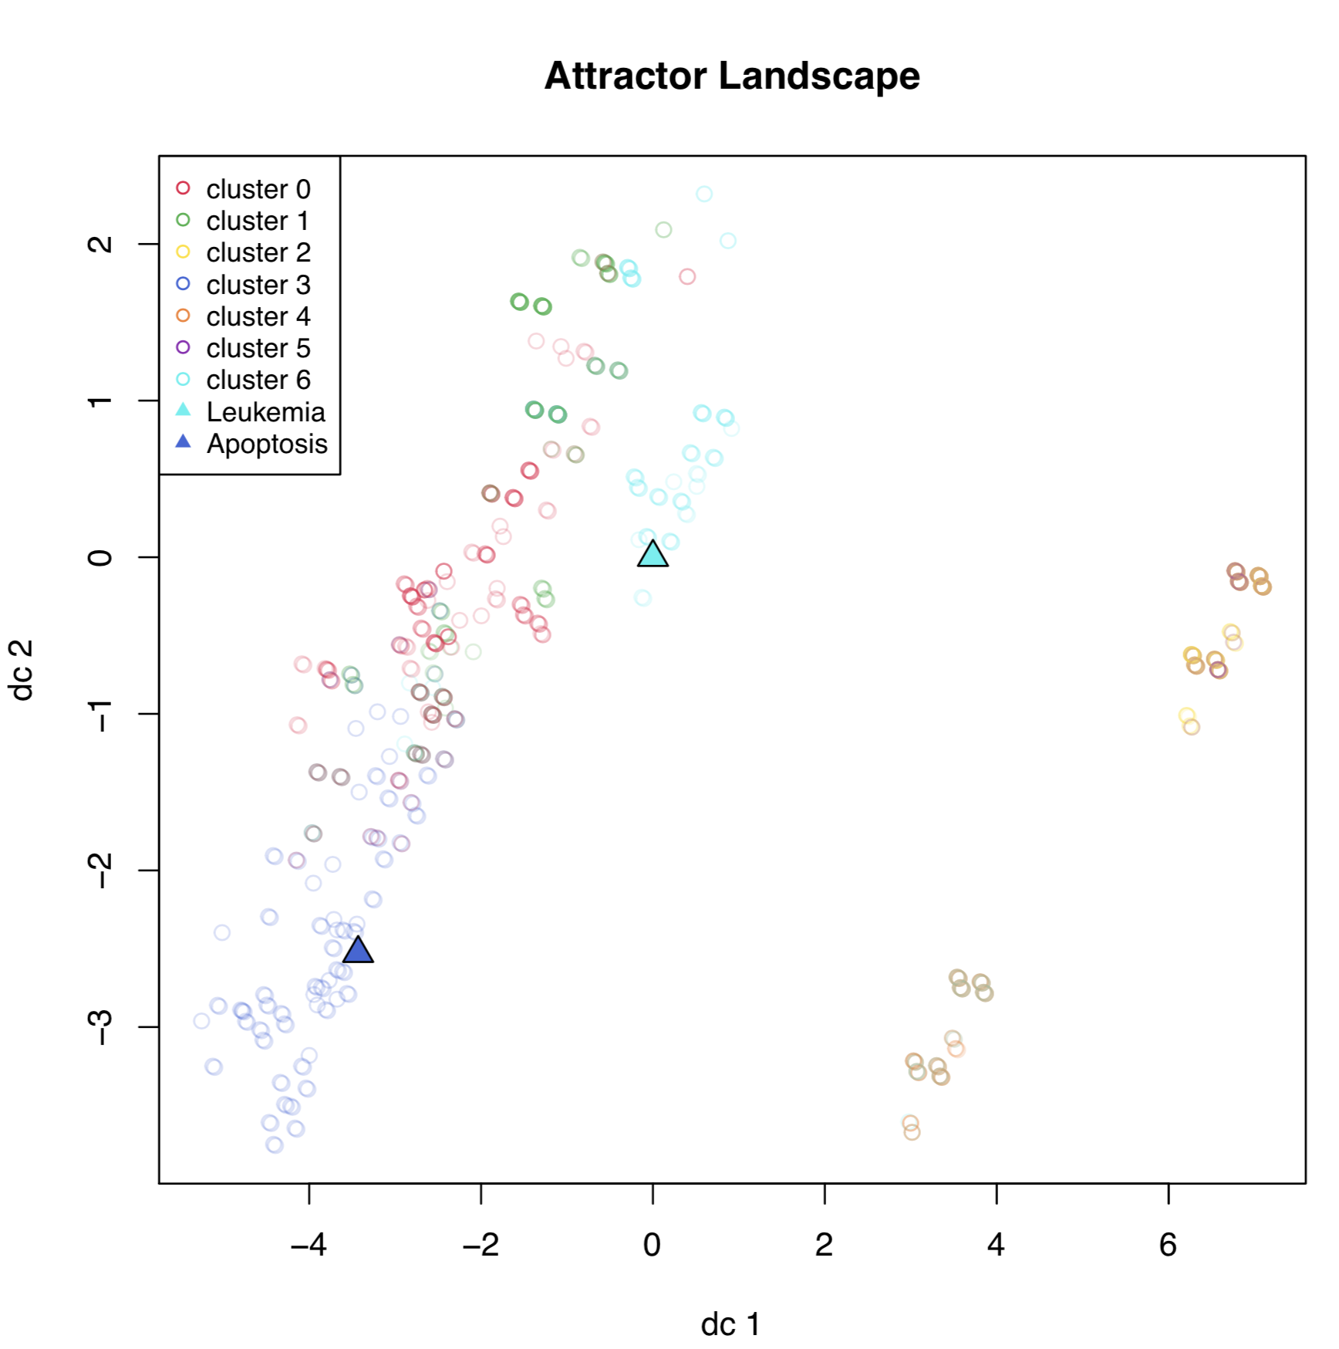
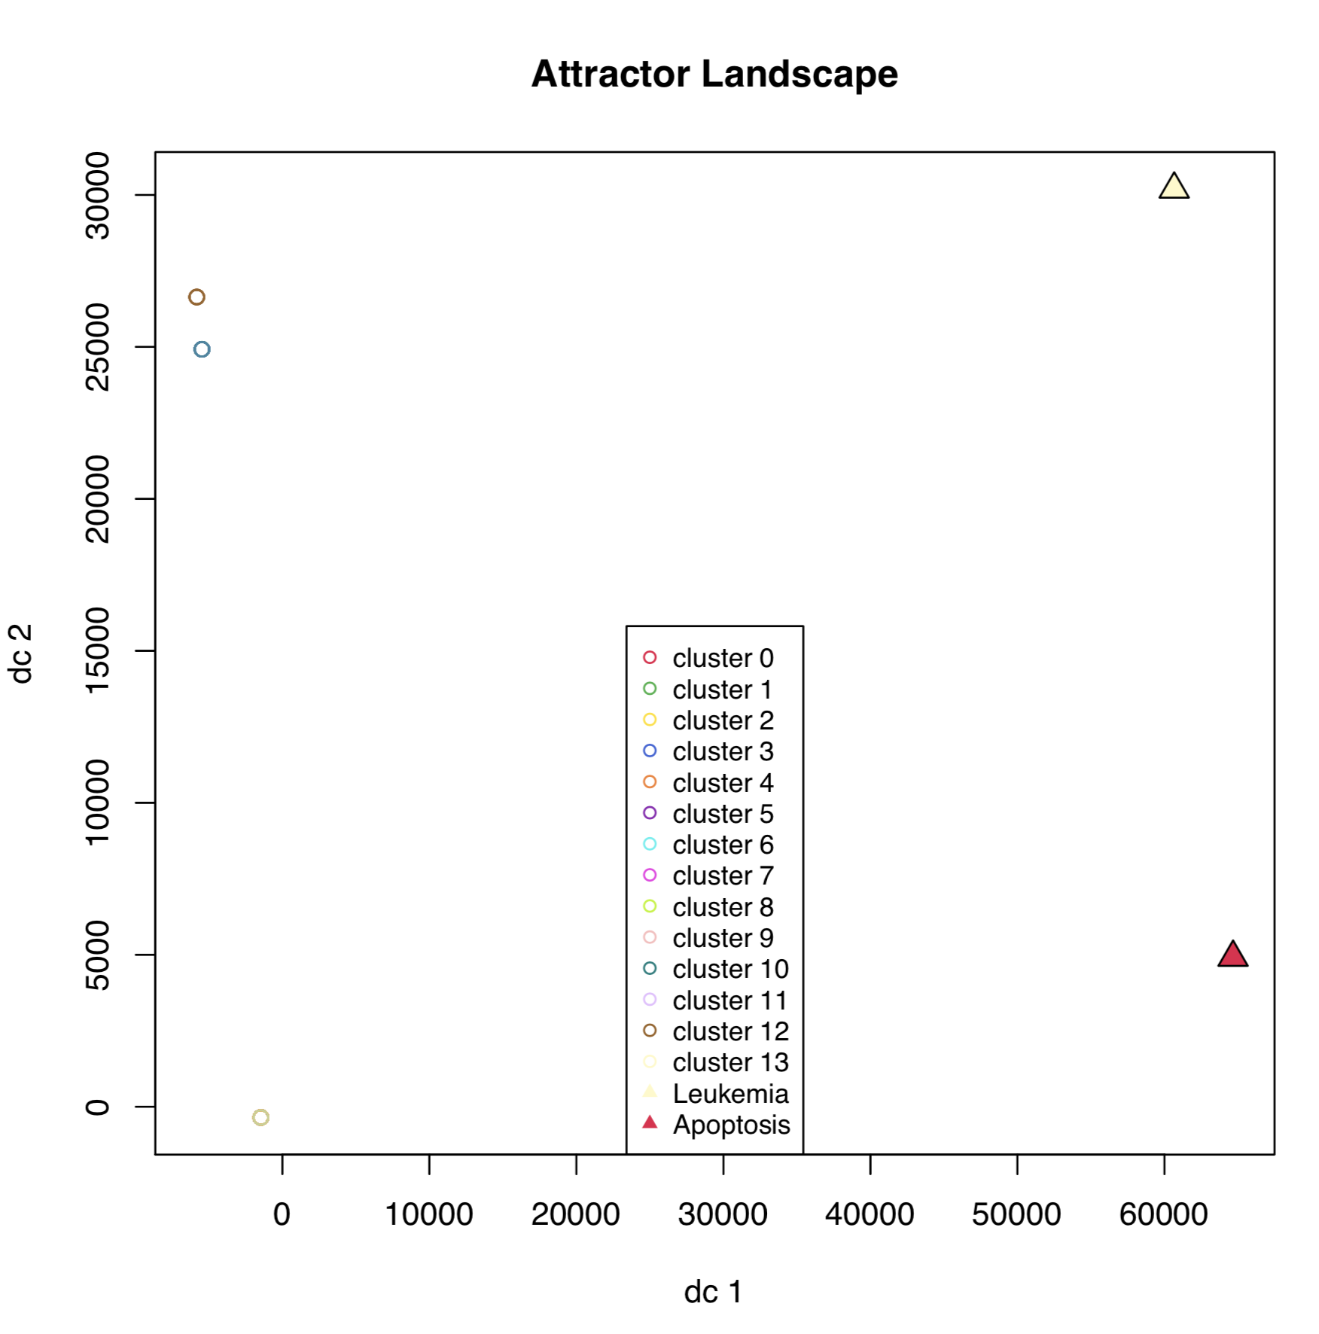
Discrete Log SS
DAC
Both

Slide 16
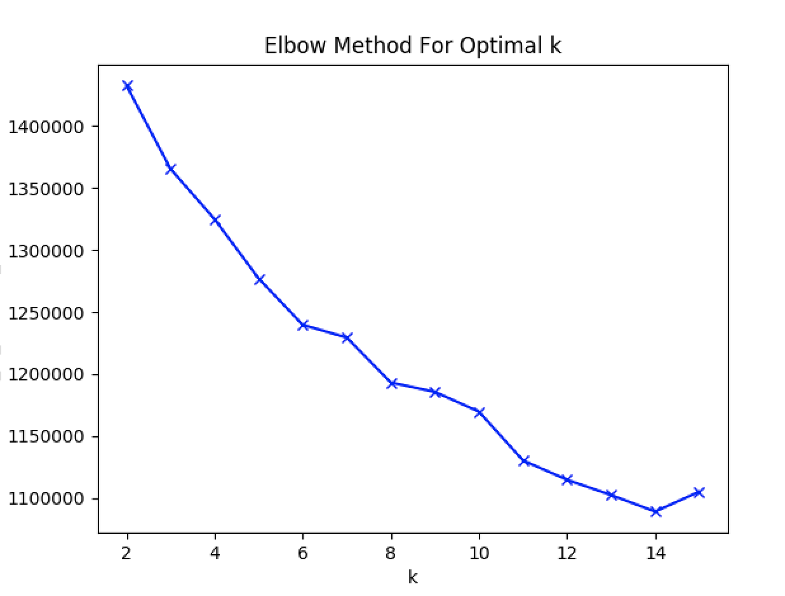
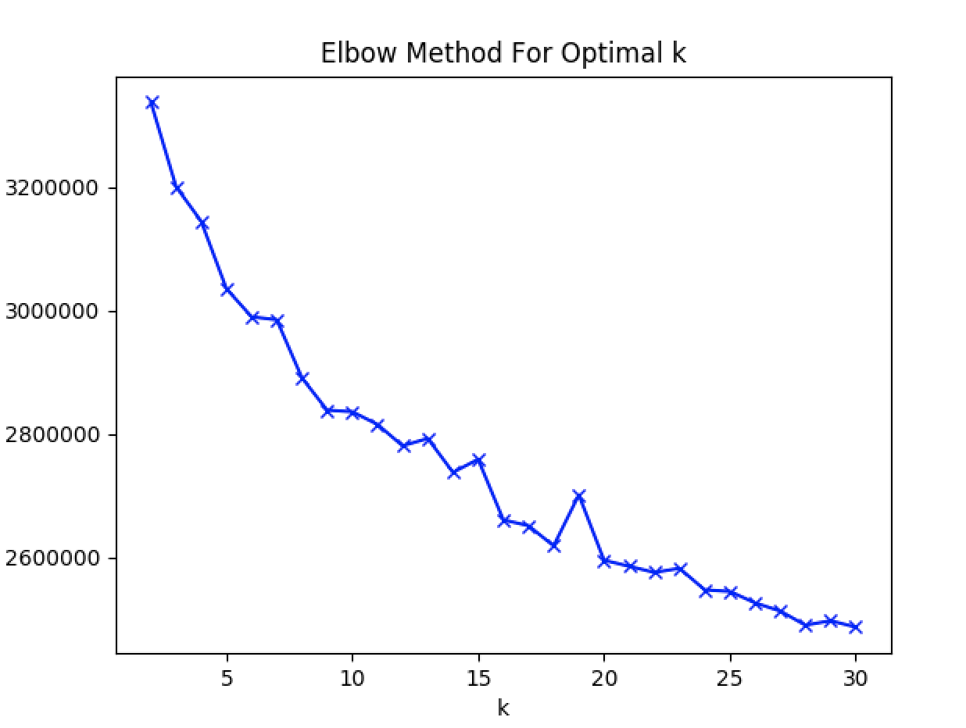
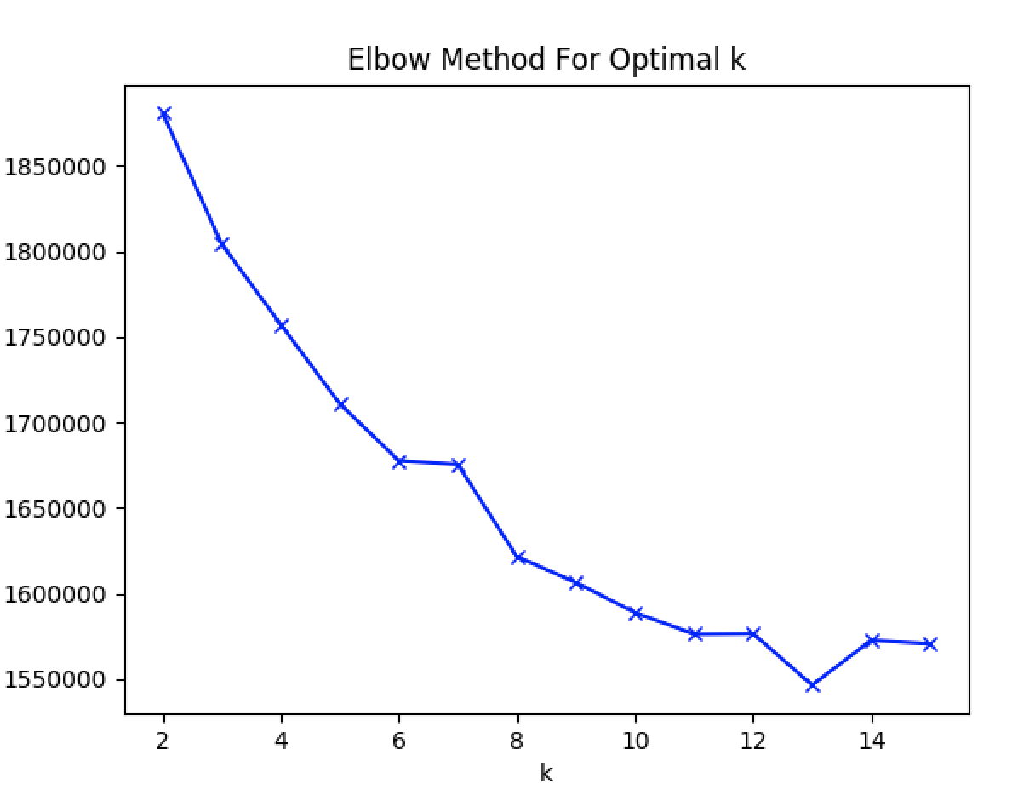
Kmeans - SFA
Discrete Log SS
K = 11
Both
K = 9
DAC
K=11

Slide 17
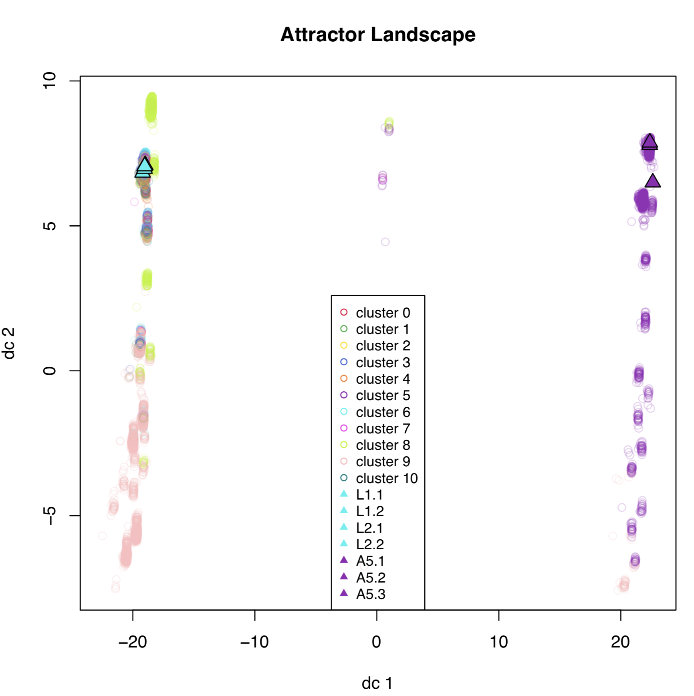
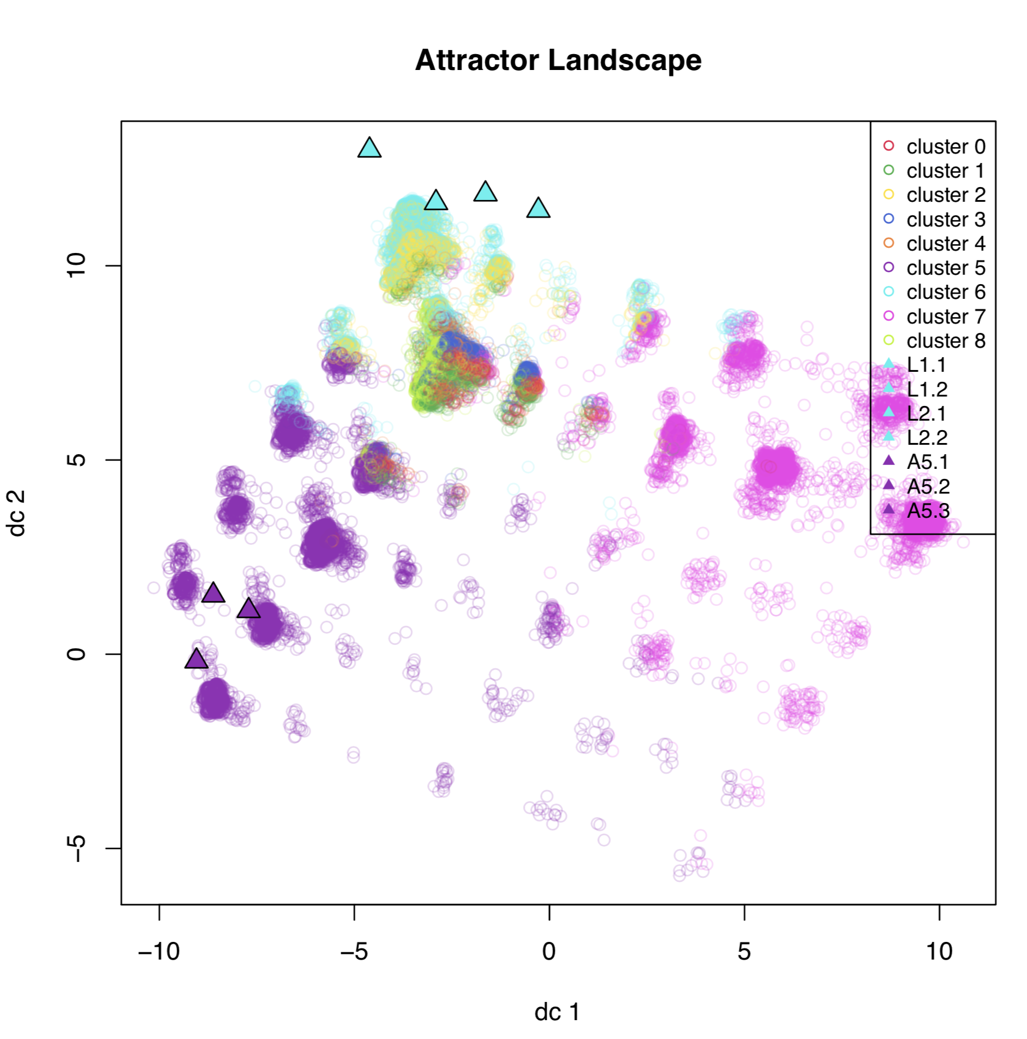
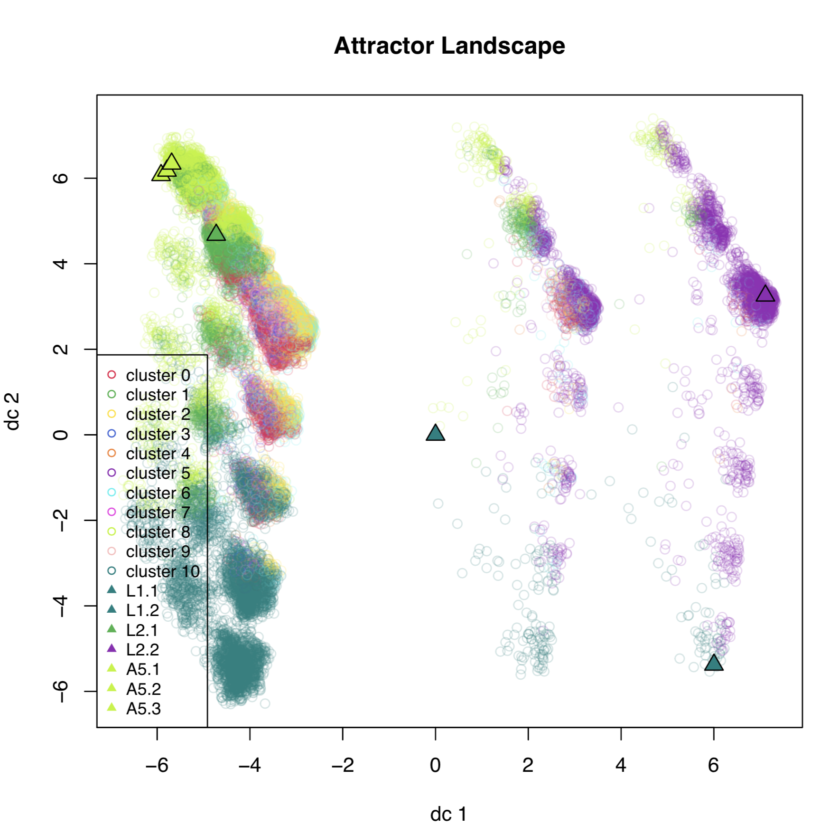
Attr
Both
DAC

Slide 18
Mapping Initial States to BoolNet Attractors
Attractor | Basin Size | Number of states in the basin that are from our random 100,000 Initial states
Apoptosis (Attr_195) | 9901 | 1396
Leukemia1 (Attr_507) | 107 | 11
Leukemia2 (Attr_284) | 615 | 82

Slide 19
Mapping Initial States to BoolNet Attractors
Attractor | Basin Size | Number of states in the basin that are from our random 100,000 Initial states | Number Classified as the correct phenotype by DAC of RONs
Apoptosis (Attr_195) | 9901 | 1396 | 48
Leukemia1 (Attr_507) | 107 | 11 | 0
Leukemia2 (Attr_284) | 615 | 82 | 0

Slide 20
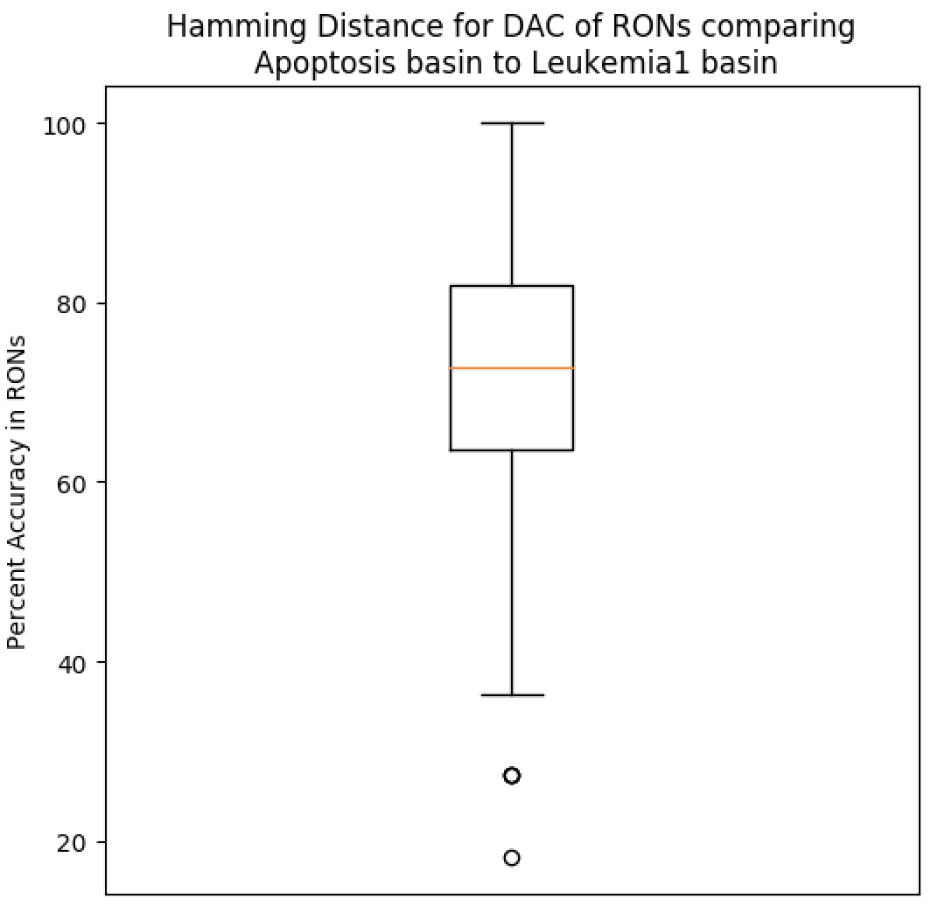
Hamming Distance of RONs
Apoptosis (1,396) Vs Leukemia1 (11) for a total of 15,357 comparisons
Percent Accuracy in RONs with non-zero DAC | Percent of Attractor Comparisons with this accuracy
100 | 4.77
90.91 | 12.61
81.82 | 21.11
72.73 | 23.58
63.64 | 19.68
54.55 | 12.93
45.45 | 4.4
36.36 | 0.89
27.27 | 0.02
18.18 | 0.01

Slide 21
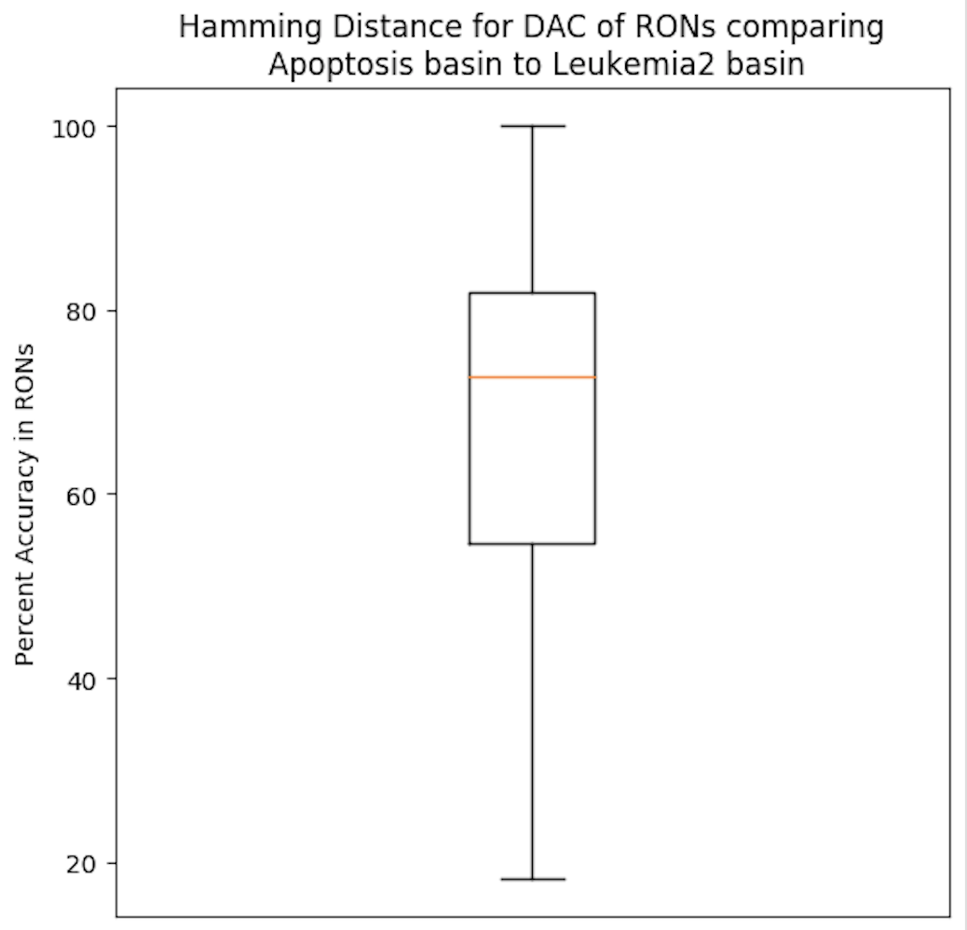
Hamming Distance of RONs
Apoptosis (1,396) Vs Leukemia2 (82) for a total of 114,472 comparisons
Percent Accuracy in RONs with non-zero DAC | Percent of Attractor Comparisons with this accuracy
100 | 5.59
90.91 | 12.36
81.82 | 17.2
72.73 | 19.7
63.64 | 18.79
54.55 | 14.6
45.45 | 8
36.36 | 3.11
27.27 | 0.63
18.18 | 0.02

Slide 22
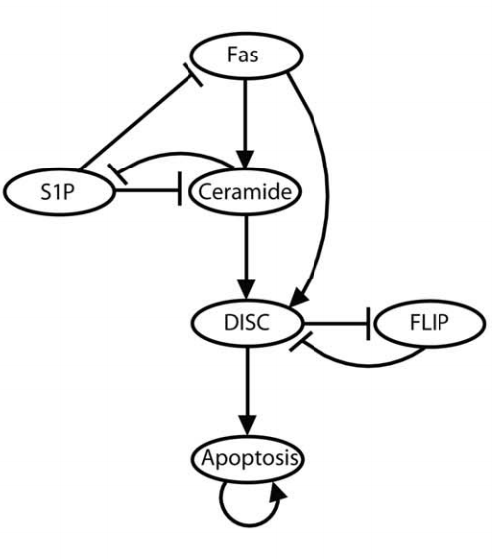
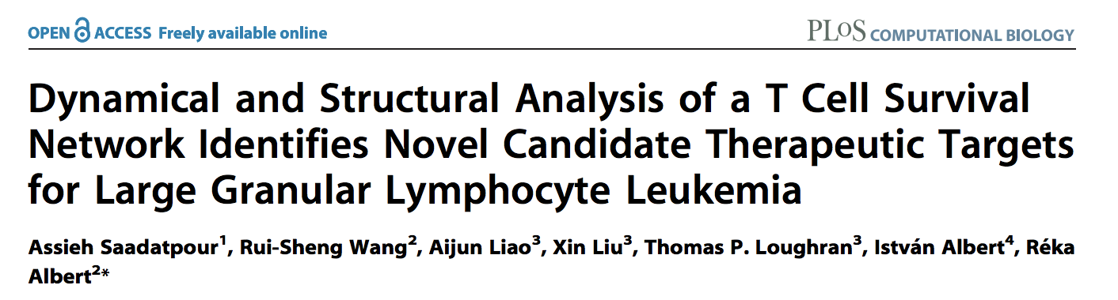
With new RONs:
Boolean DAC
Experimentally Validated
In the reduced network of Saadatpour
RONs for Zanudo
Non-zero DAC

Slide 23
Classify 877 Boolean Attractors
Boolean DAC
31 Leukemia Attractors (3.5%)
133 Apoptosis Attractors (15.2%)
713 Other Attractors (81.3%)
Previously: No change!
31 Leukemia (3.5%)
133 Apoptosis (15.2%)
713 “Other” (81.3%)

Slide 24
Classify 100,000 SFA Attractors
Boolean DAC
423 Leukemia Attractors (0.42%)
20647 Apoptosis Attractors (20.65%)
78930 Other Attractors (78.93%)
Previously:
299 Leukemia (0.30%)
20647 Apoptosis (20.65%)
79054 Other (79%)

Slide 25
Hamming Distance
Boolean DAC
Old RONs
Percent Accuracy in RONs with non-zero DAC | Percent of Attractor Comparisons with this accuracy
100 | 5.49
90.91 | 12.39
81.82 | 17.66
72.73 | 20.16
63.64 | 18.9
54.55 | 14.4
45.45 | 7.57
36.36 | 2.85
27.27 | 0.56
18.18 | 0.02
New RONs
Percent Accuracy in RONs with non-zero DAC | Percent of Attractor Comparisons with this accuracy
100 | 7.98
85.71 | 18.78
71.43 | 25.19
57.14 | 24.28
42.86 | 15.29
28.57 | 6.79
14.29 | 1.65
0 | 0.02

Slide 26
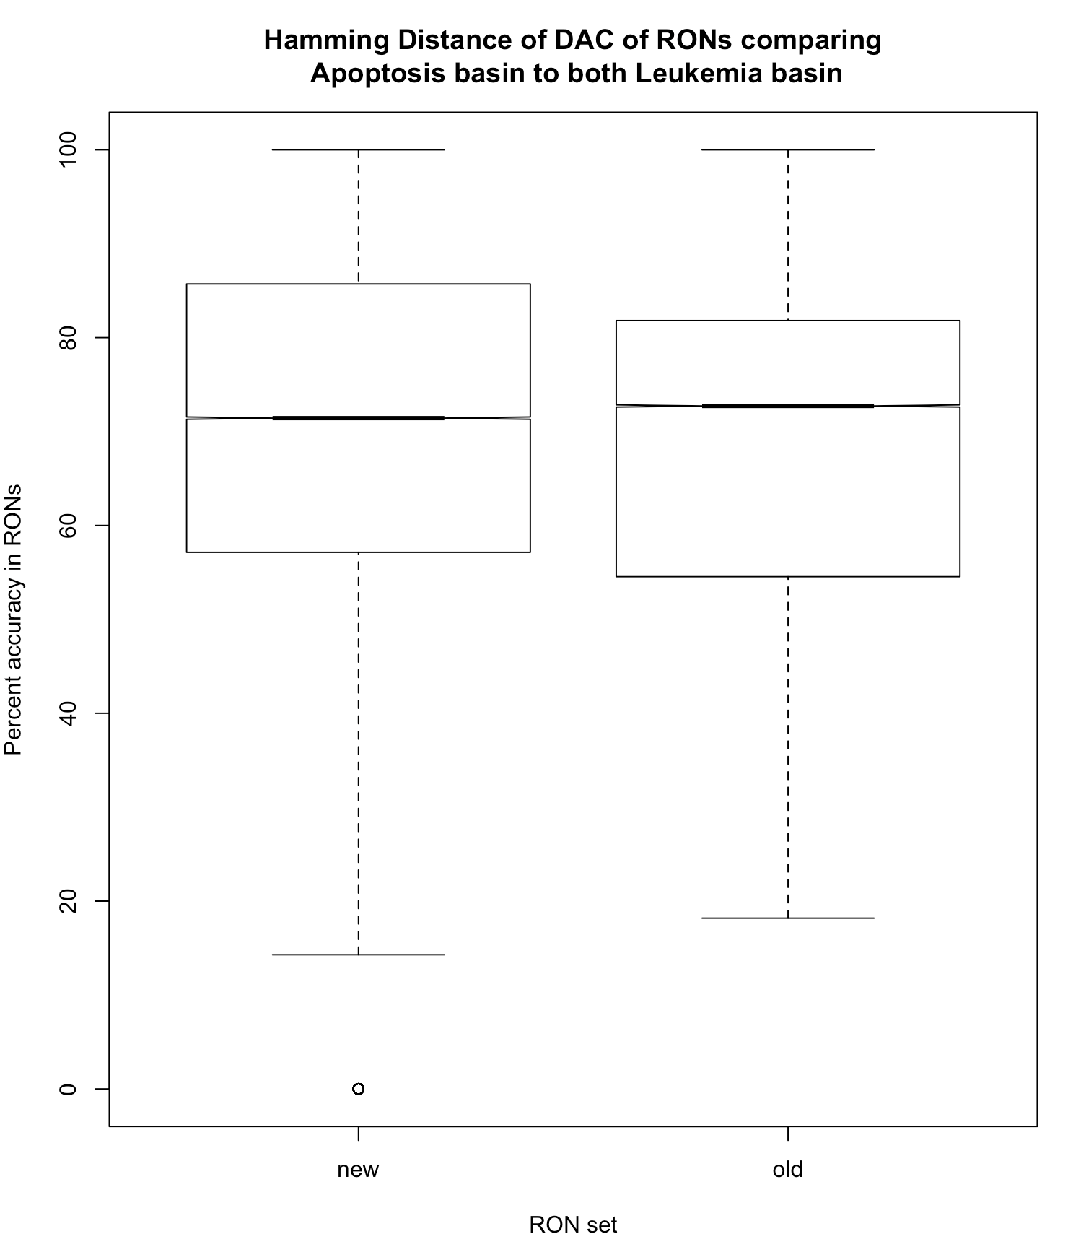
Boolean DAC of New Readout Nodes
Boolean DAC of Old Readout Nodes

Slide 27
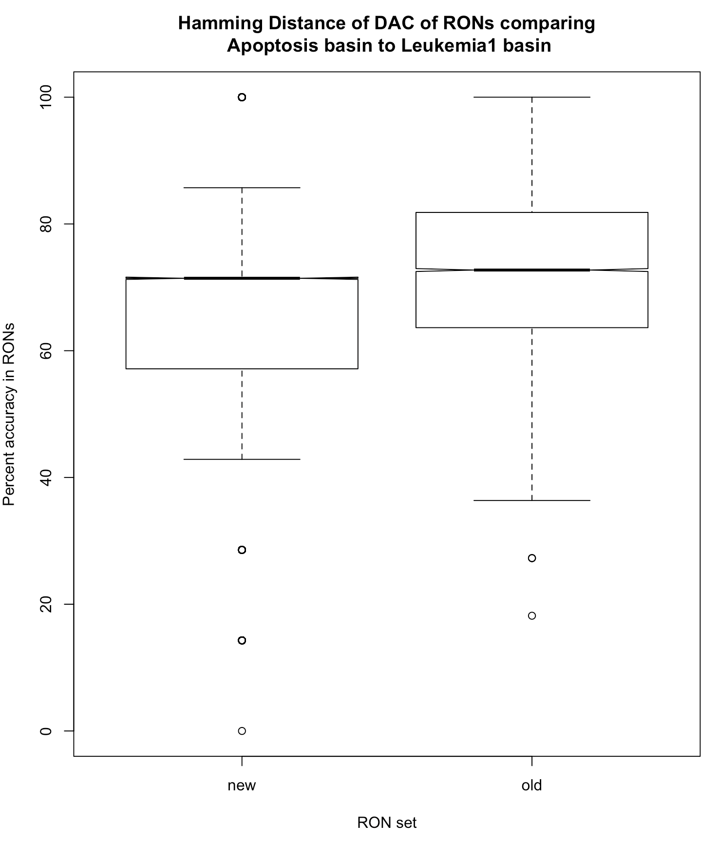
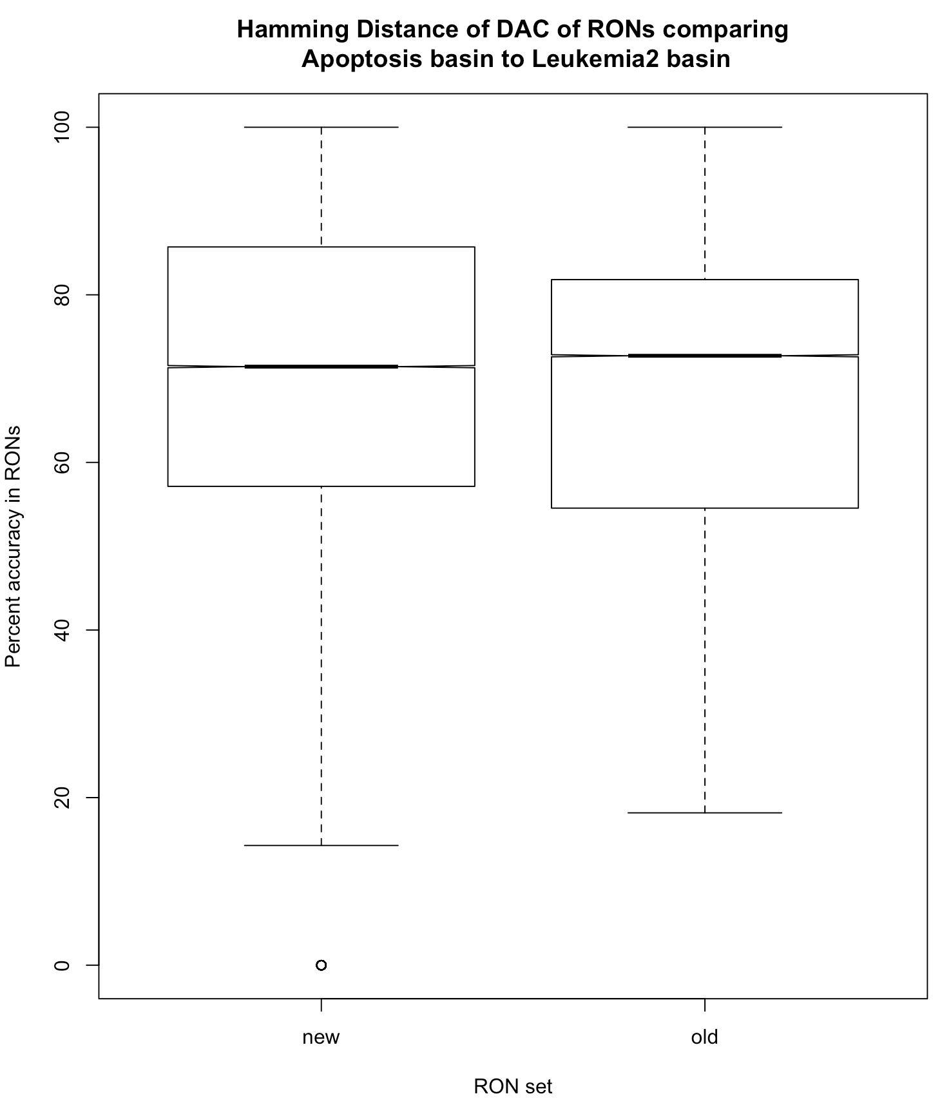

Slide 28
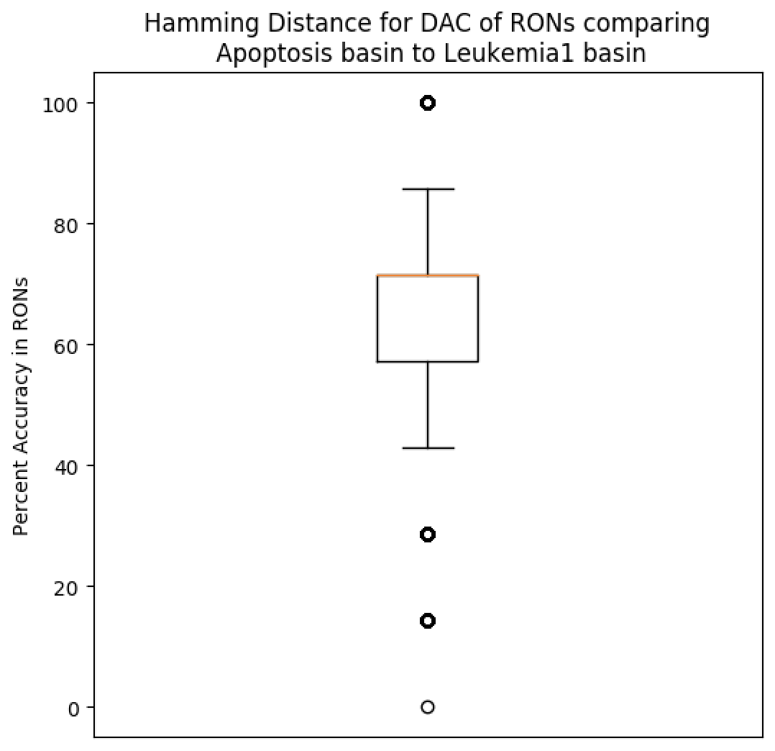
Hamming Distance of RONs
Boolean DAC
Apoptosis (1,396) Vs Leukemia1 (11) for a total of 15,357 comparisons
Percent Accuracy in RONs with non-zero DAC | Percent of Attractor Comparisons with this accuracy
100 | 5.51
85.71 | 17.63
71.43 | 28.73
57.14 | 26.21
42.86 | 15.92
28.57 | 5.14
14.29 | 0.85
0 | 0.01

Slide 29

Hamming Distance of RONs
Boolean DAC
Apoptosis (1,396) Vs Leukemia2 (82) for a total of 114,472 comparisons
Percent Accuracy in RONs with non-zero DAC | Percent of Attractor Comparisons with this accuracy
100 | 8.32
85.71 | 18.93
71.43 | 24.72
57.14 | 24.02
42.86 | 15.21
28.57 | 7.02
14.29 | 1.76
0 | 0.02

Slide 30
K-means Cluster Breakdown Number of clusters that achieves separation between leuk and apop:
BoolNet
SFA
Both
2
3
4
5
6
7
9
11
12
13
14
15
Attractor state
2
4
5
8
9
10
11
12
13
DAC
2
3
4
5
7
8
9
10
11
12
14
Both
9
12
Log steady state
8
10
11
12
13
15
DAC
15

Slide 31
“Mega K-means”
K-means on SFA attractors using n-tuples of discrete steady state log value plus DAC against each of the 93 leukemia SFA attractors
Never see a leukemia-only cluster
Best results with 6 clusters
 | Apoptosis (N = 20647) |  | Leukemia (N = 423)
Cluster Number | Number of attractors in cluster | Percent of attractors in cluster | Number of attractors in cluster | Percent of attractors in cluster
0 | 1805 | 8.74 | 47 | 11.11
1 | 3461 | 16.76 | 128 | 30.26
2 | 1761 | 8.53 | 177 | 41.84
3 | 3252 | 15.75 | 4 | 0.95
4 | 1606 | 7.78 | 67 | 15.84
5 | 8762 | 42.44 | 0 | 0
Largest Percent of Leukemia Attractors
Largest Percent of Apoptosis Attractors

Slide 32
Distribution of 93 leukemia and 1396 apoptosis SFA attractors when clustered with 4 Clusters:
Distribution of 93 leukemia and 1396 apoptosis SFA attractors when clustered with 5 Clusters:
 | Apoptosis (N = 1396) |  | Leukemia (N = 93)
cluster number | Number of attractors in cluster | Percent of attractors in cluster | Number of attractors in cluster | Percent of attractors in cluster
0 | 310 | 22.21 | 6 | 6.45
1 | 365 | 26.15 | 19 | 20.43
2 | 254 | 18.19 | 9 | 9.68
3 | 0 | 0 | 45 | 48.39
4 | 467 | 33.45 | 14 | 15.05
 | Apoptosis (N = 1396) |  | Leukemia (N = 93)
cluster number | Number of attractors in cluster | Percent of attractors in cluster | Number of attractors in cluster | Percent of attractors in cluster
0 | 638 | 45.7 | 21 | 22.58
1 | 379 | 27.15 | 12 | 12.9
2 | 379 | 27.15 | 9 | 9.68
3 | 0 | 0 | 51 | 54.84
Distribution of 93 leukemia and 1396 apoptosis SFA attractors when clustered with 6 Clusters:
 | Apoptosis (N = 1396) |  | Leukemia (N = 93)
cluster number | Number of attractors in cluster | Percent of attractors in cluster | Number of attractors in cluster | Percent of attractors in cluster
0 | 193 | 13.83 | 5 | 5.38
1 | 0 | 0 | 40 | 43.01
2 | 279 | 19.99 | 6 | 6.45
3 | 188 | 13.47 | 9 | 9.68
4 | 373 | 26.72 | 23 | 24.73
5 | 363 | 26 | 10 | 5.38
There are 34 Leukemia attractors that always cluster together regardless of K

Slide 33
*DAC compared to the median value for the 93 Leukemia Attractors
DAC:
 | Value of DAC
Readout Node | 1 | 0 | -1
Apoptosis | 19 | 1 | 14
BID | 15 | 0 | 19
Ceramide | 0 | 1 | 33
DISC | 14 | 0 | 20
FAS | 0 | 1 | 33
IAP | 18 | 1 | 15
S1P | 33 | 1 | 0

Slide 34
*DAC compared to the median value for the 93 Leukemia Attractors

Slide 35
Recall:
Classify 877 Boolean Attractors
31 Leukemia Attractors (3.5%)
133 Apoptosis Attractors (15.2%)
713 Other Attractors (81.3%)
I wanted to quickly look at all the initial states that go to the 31 Leukemia Attractors and the 133 Apoptosis Attractors in the Boolean.
(9625 initial states go to Leukemia attractors and 37012 initial states go to Apoptosis Attractors)

Slide 36
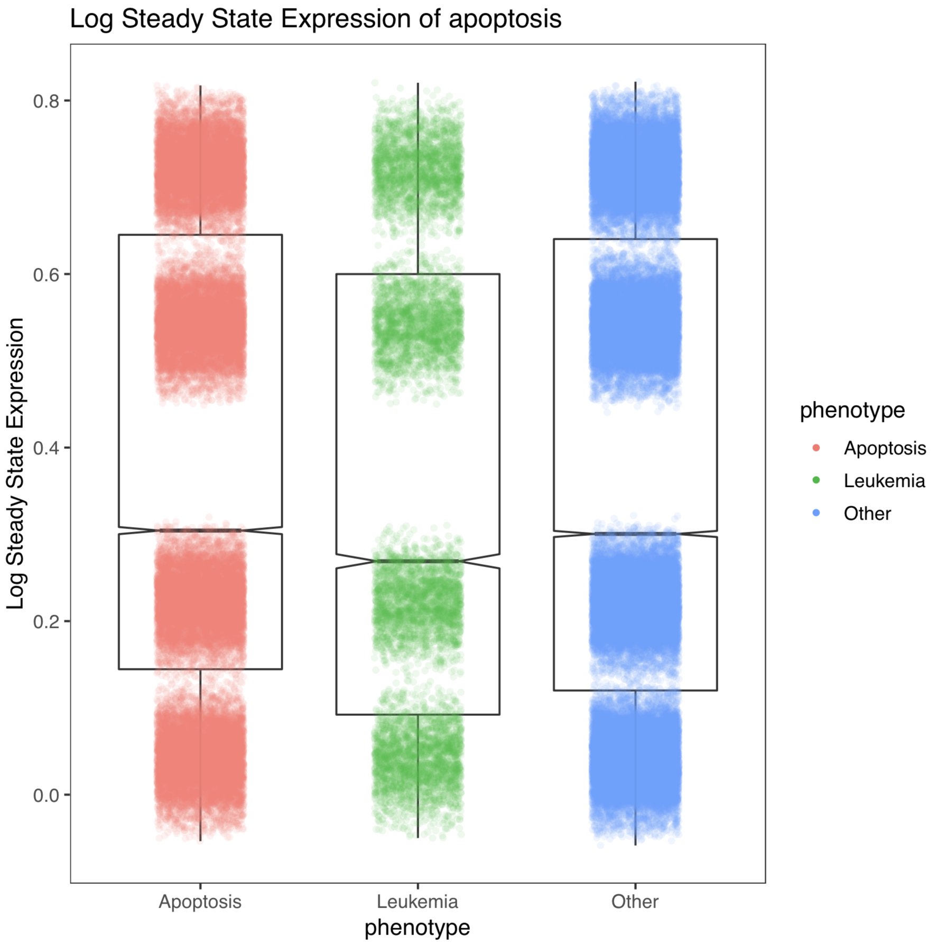
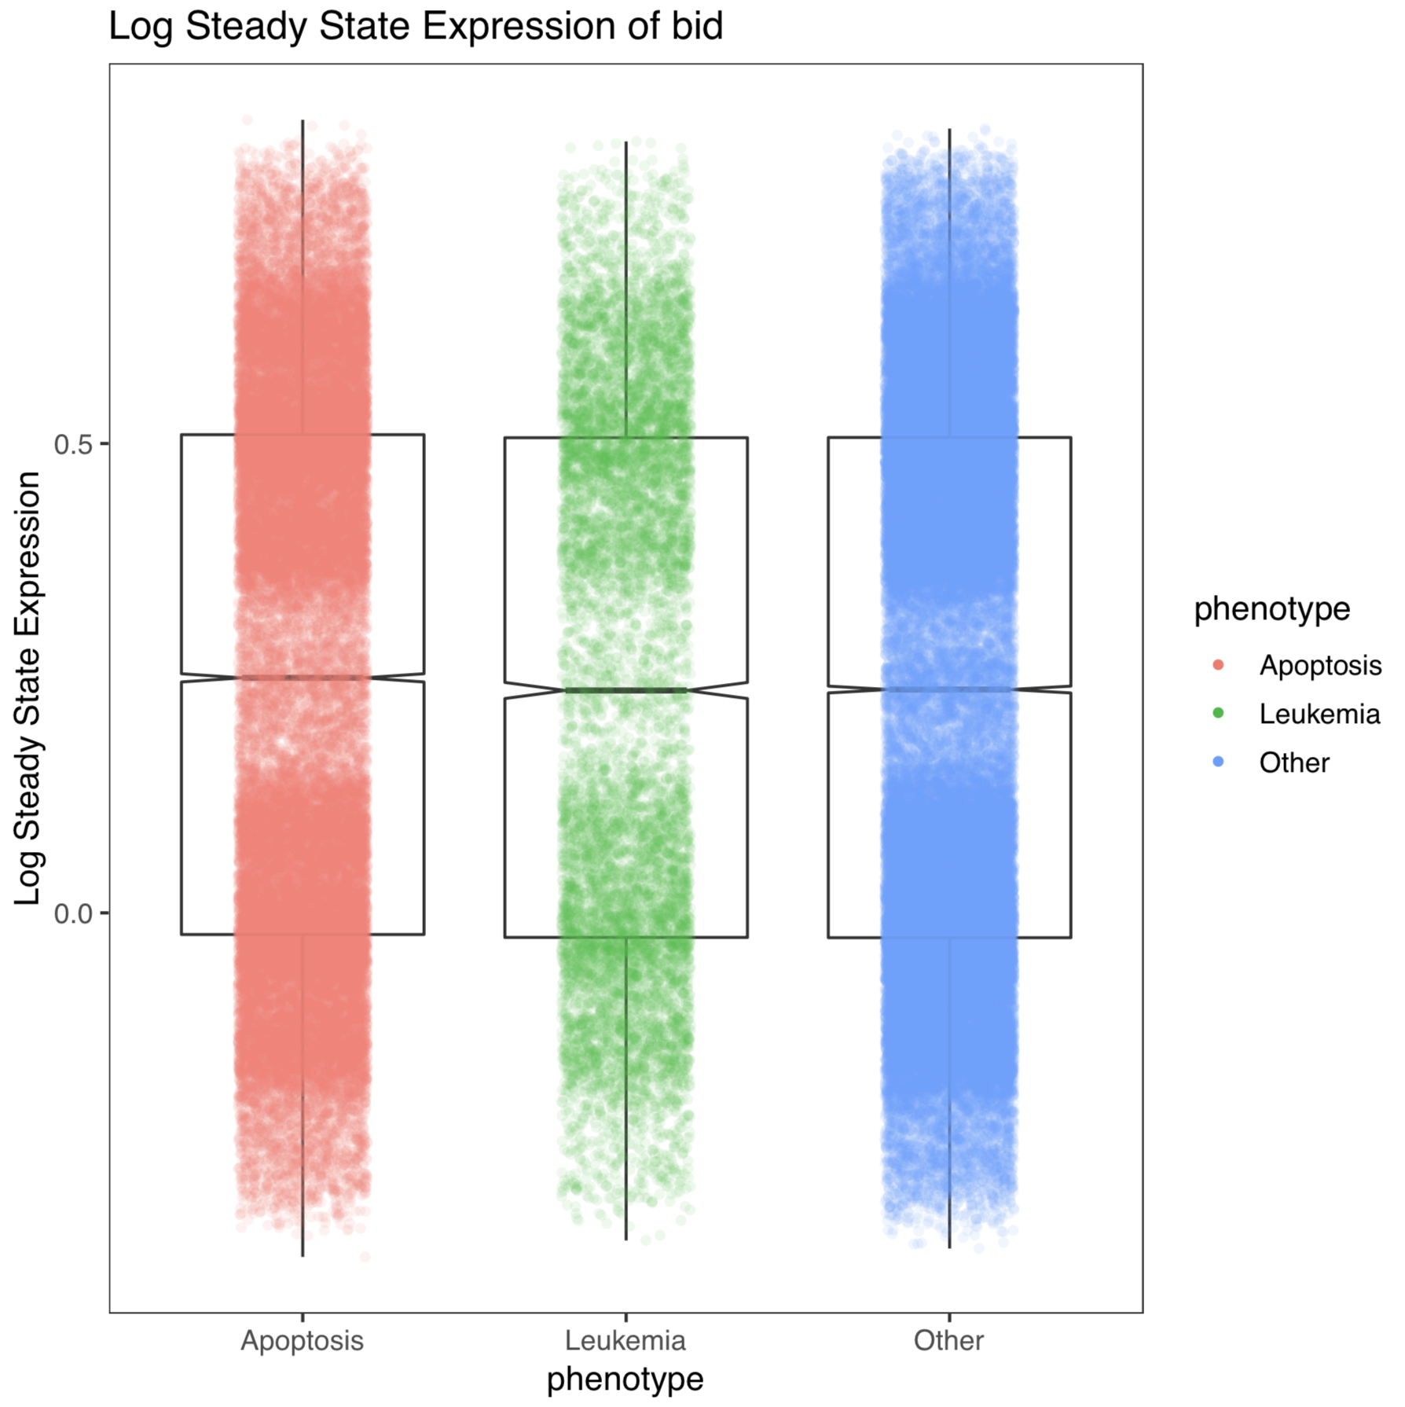
37012 attractors
9625 attractors

Slide 37
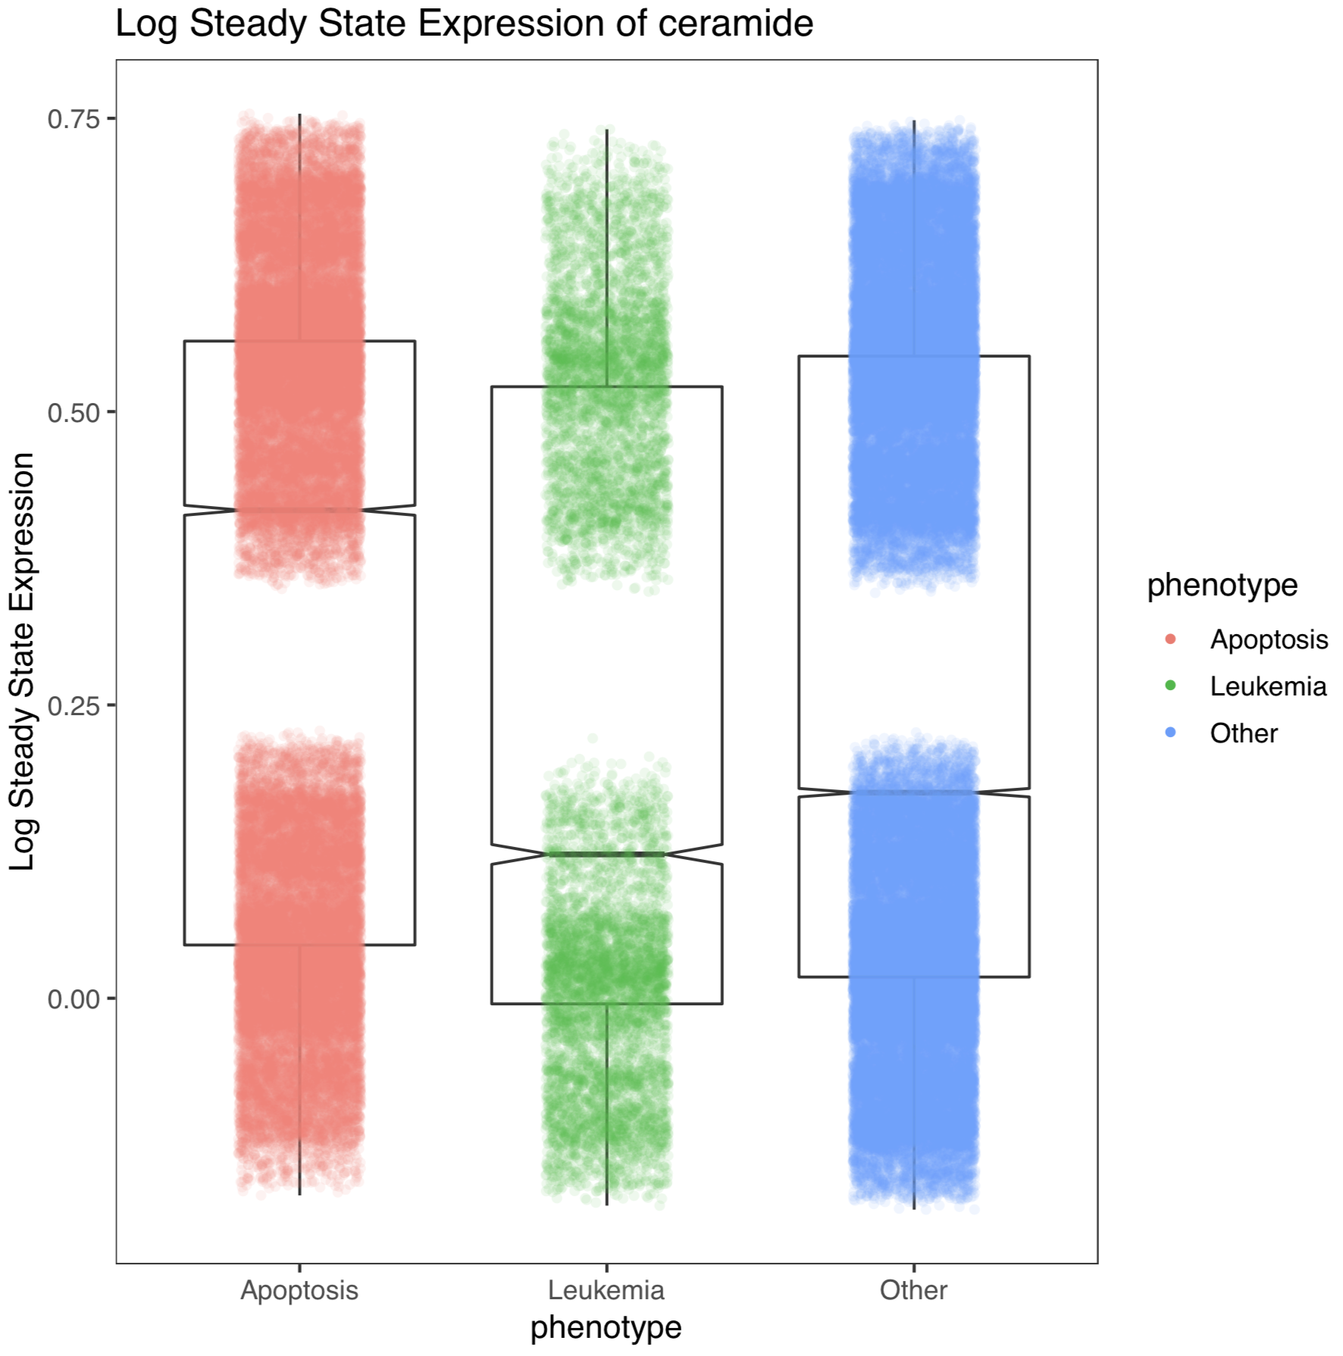
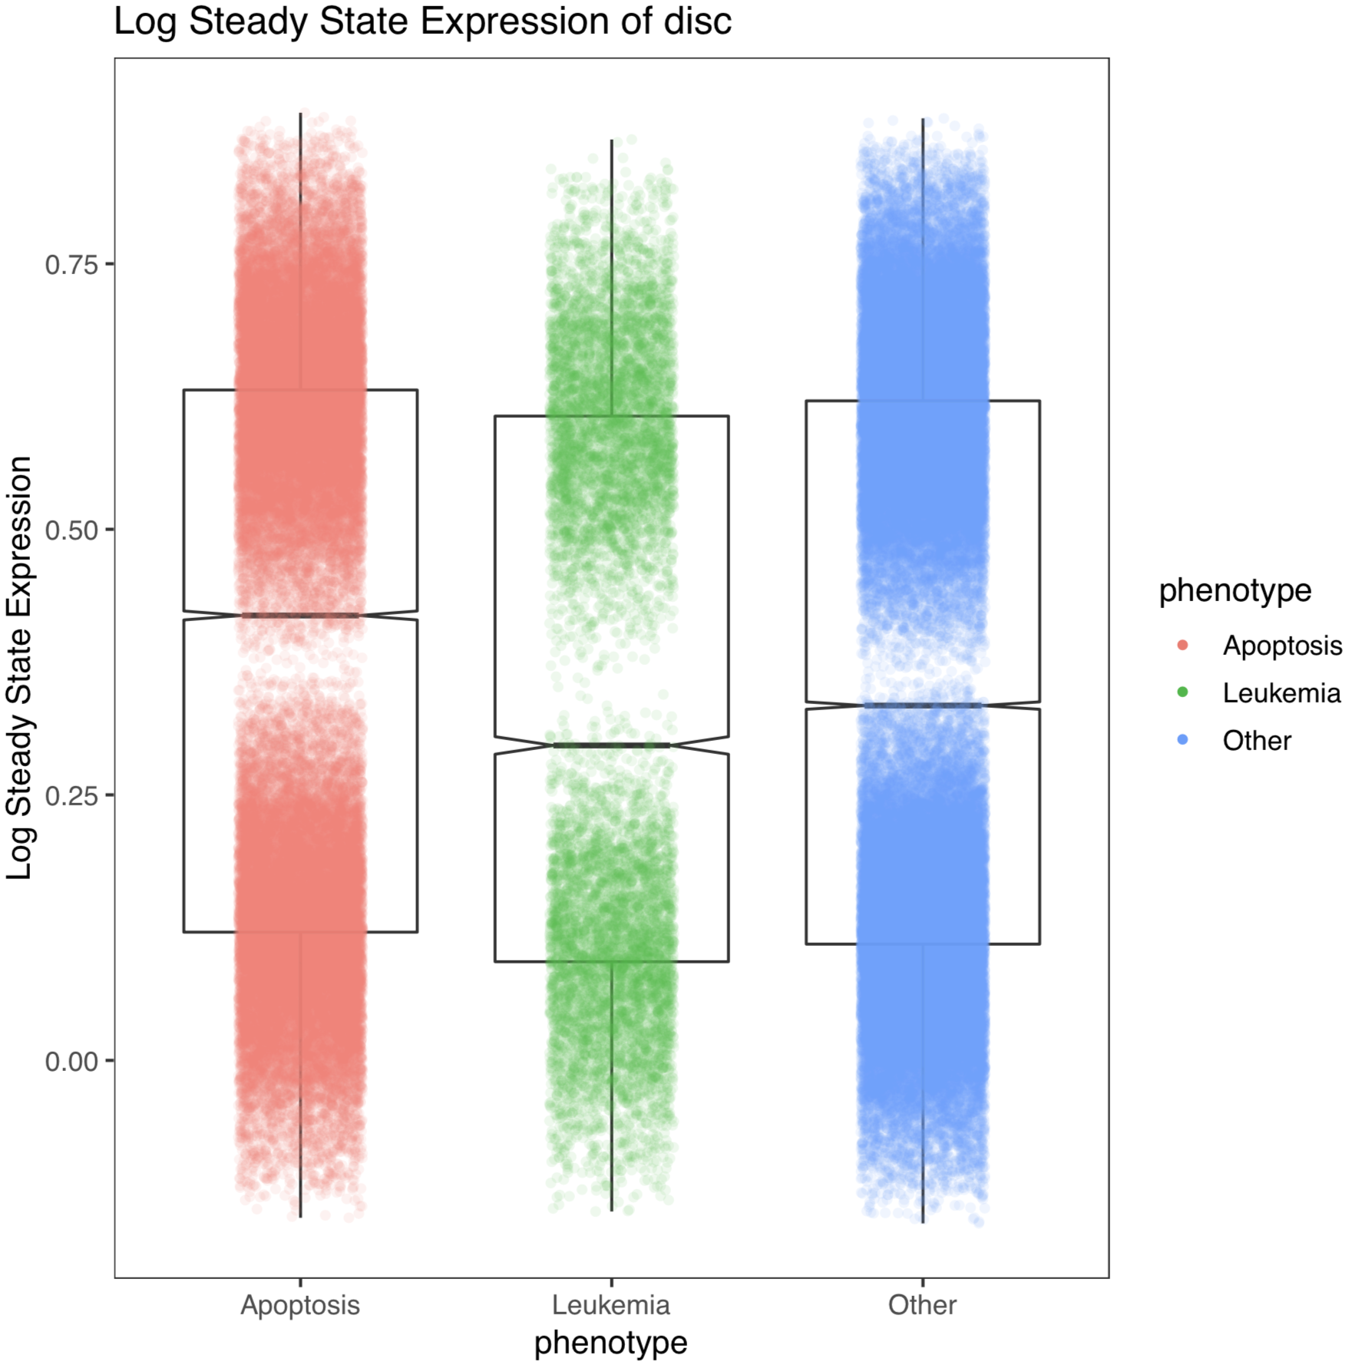

Slide 38
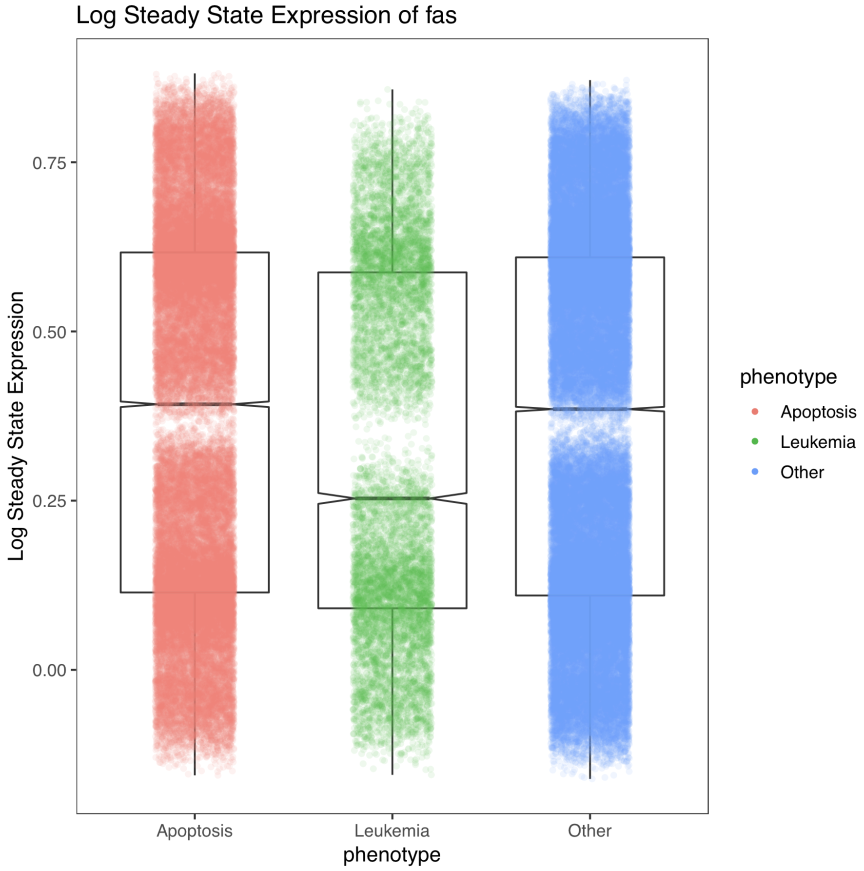
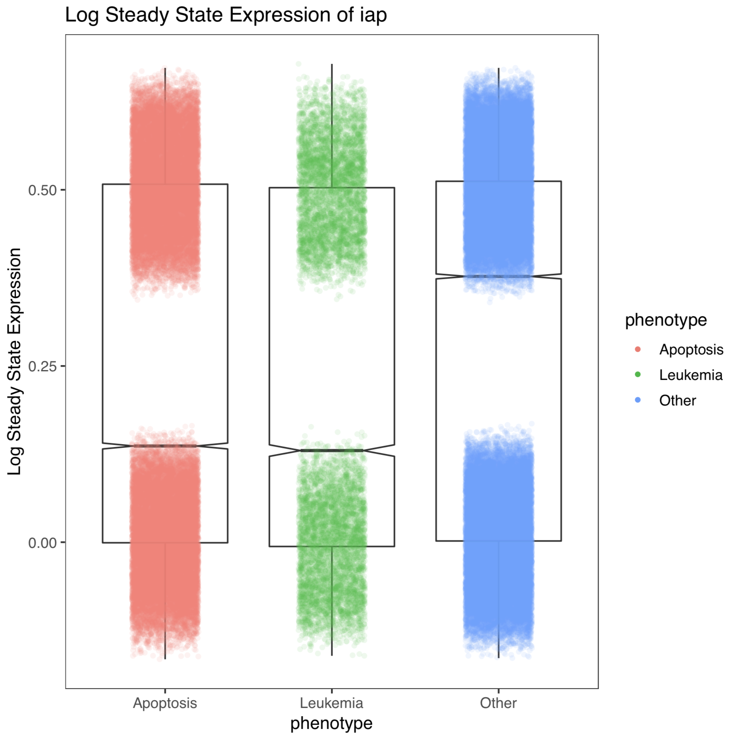

Slide 39
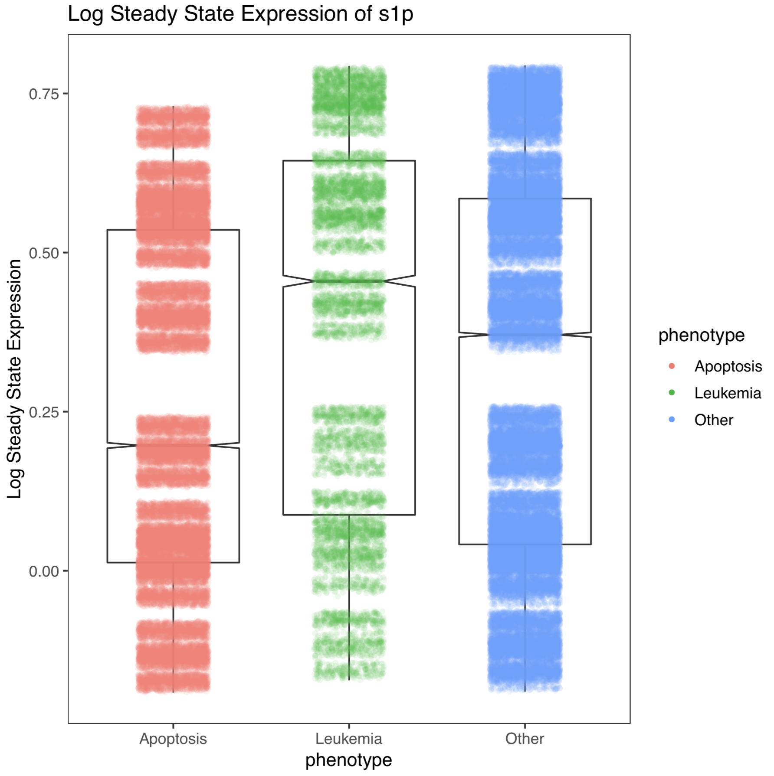

Slide 40
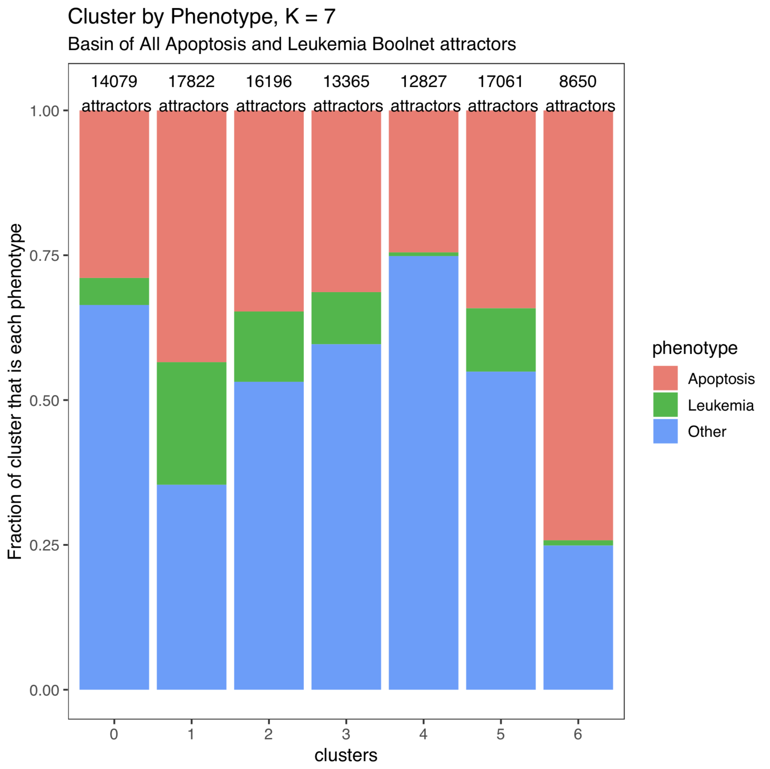
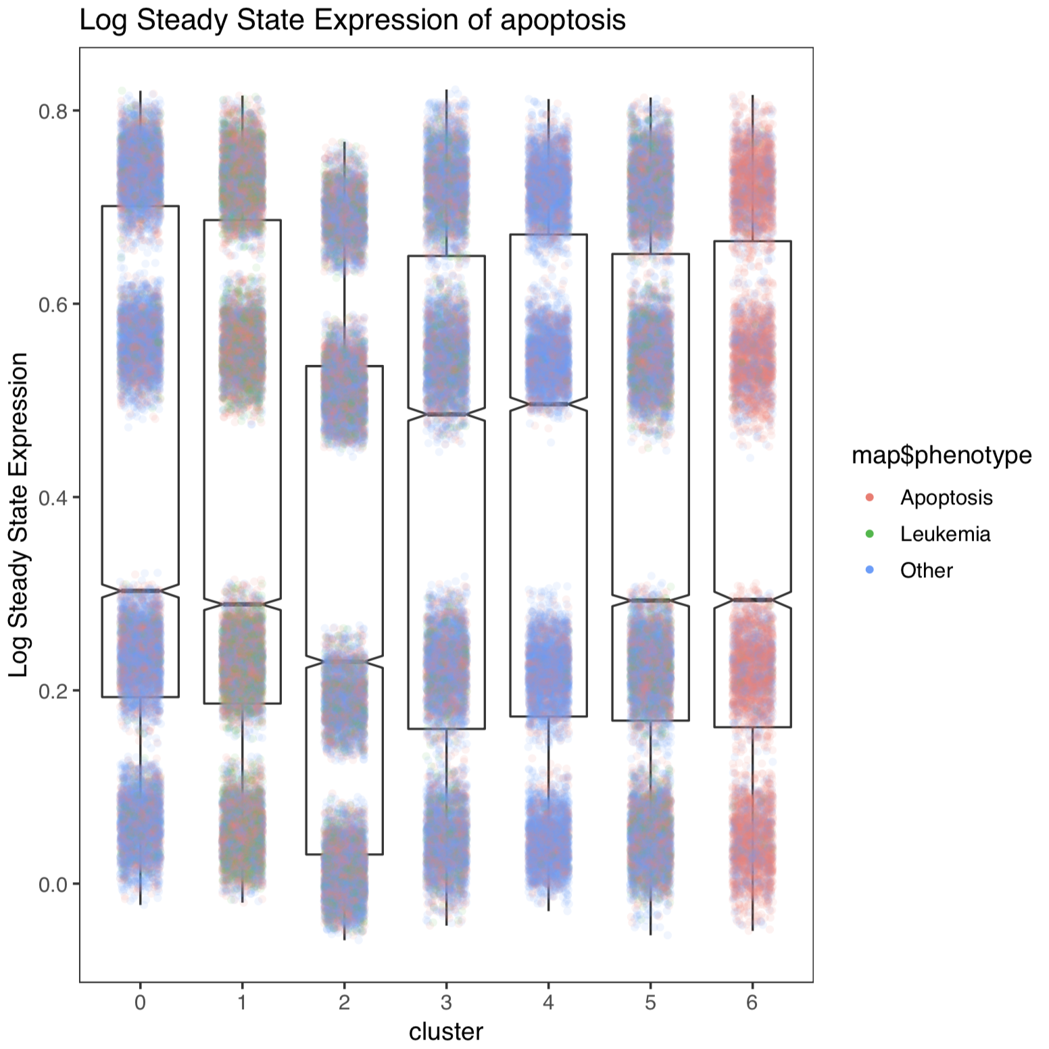

Slide 41
Think back to first part when we had initializations from Zanudo…
… In the Boolean this lead to 2 Leukemia attractors and 1 Apoptosis Attractor

Slide 42
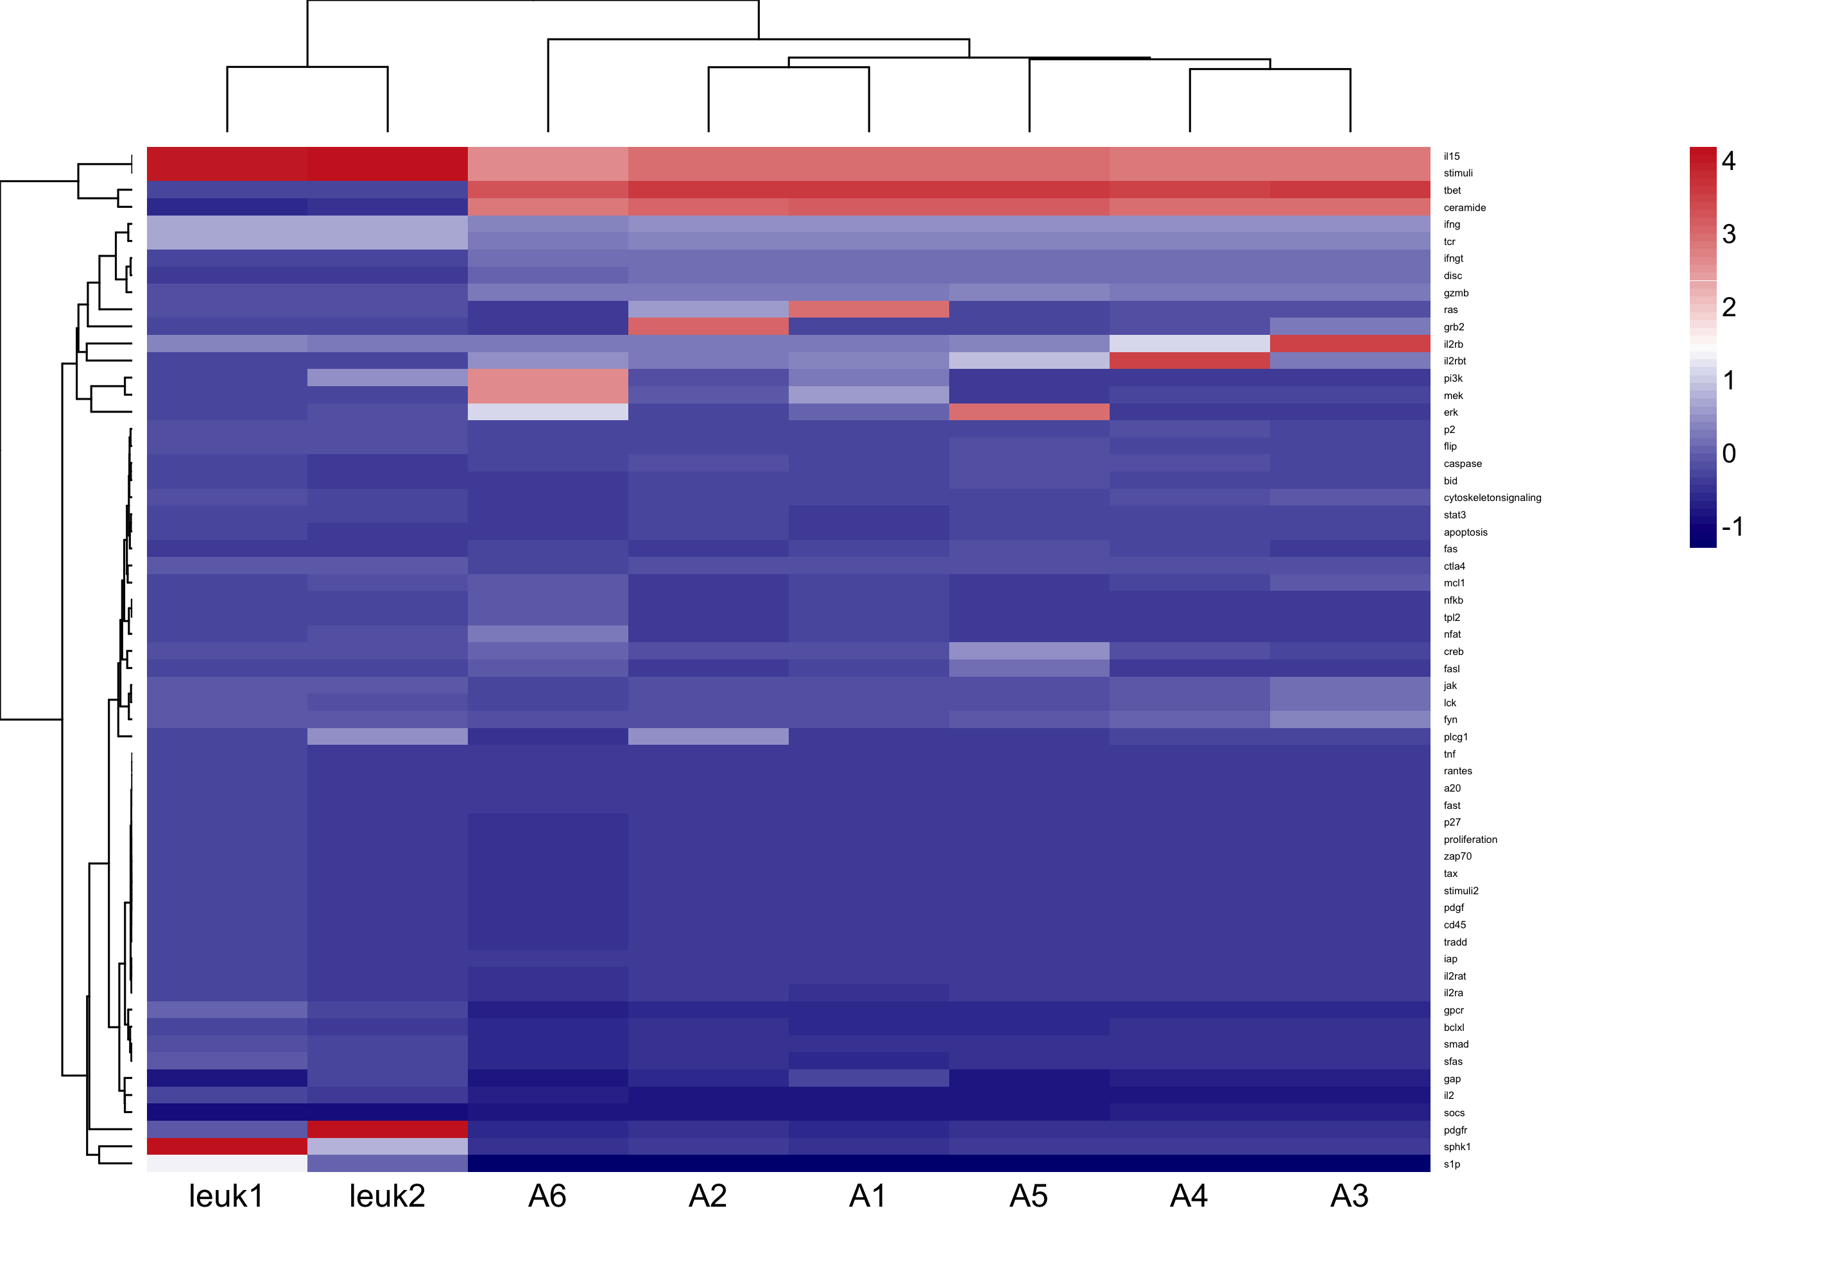

Slide 43
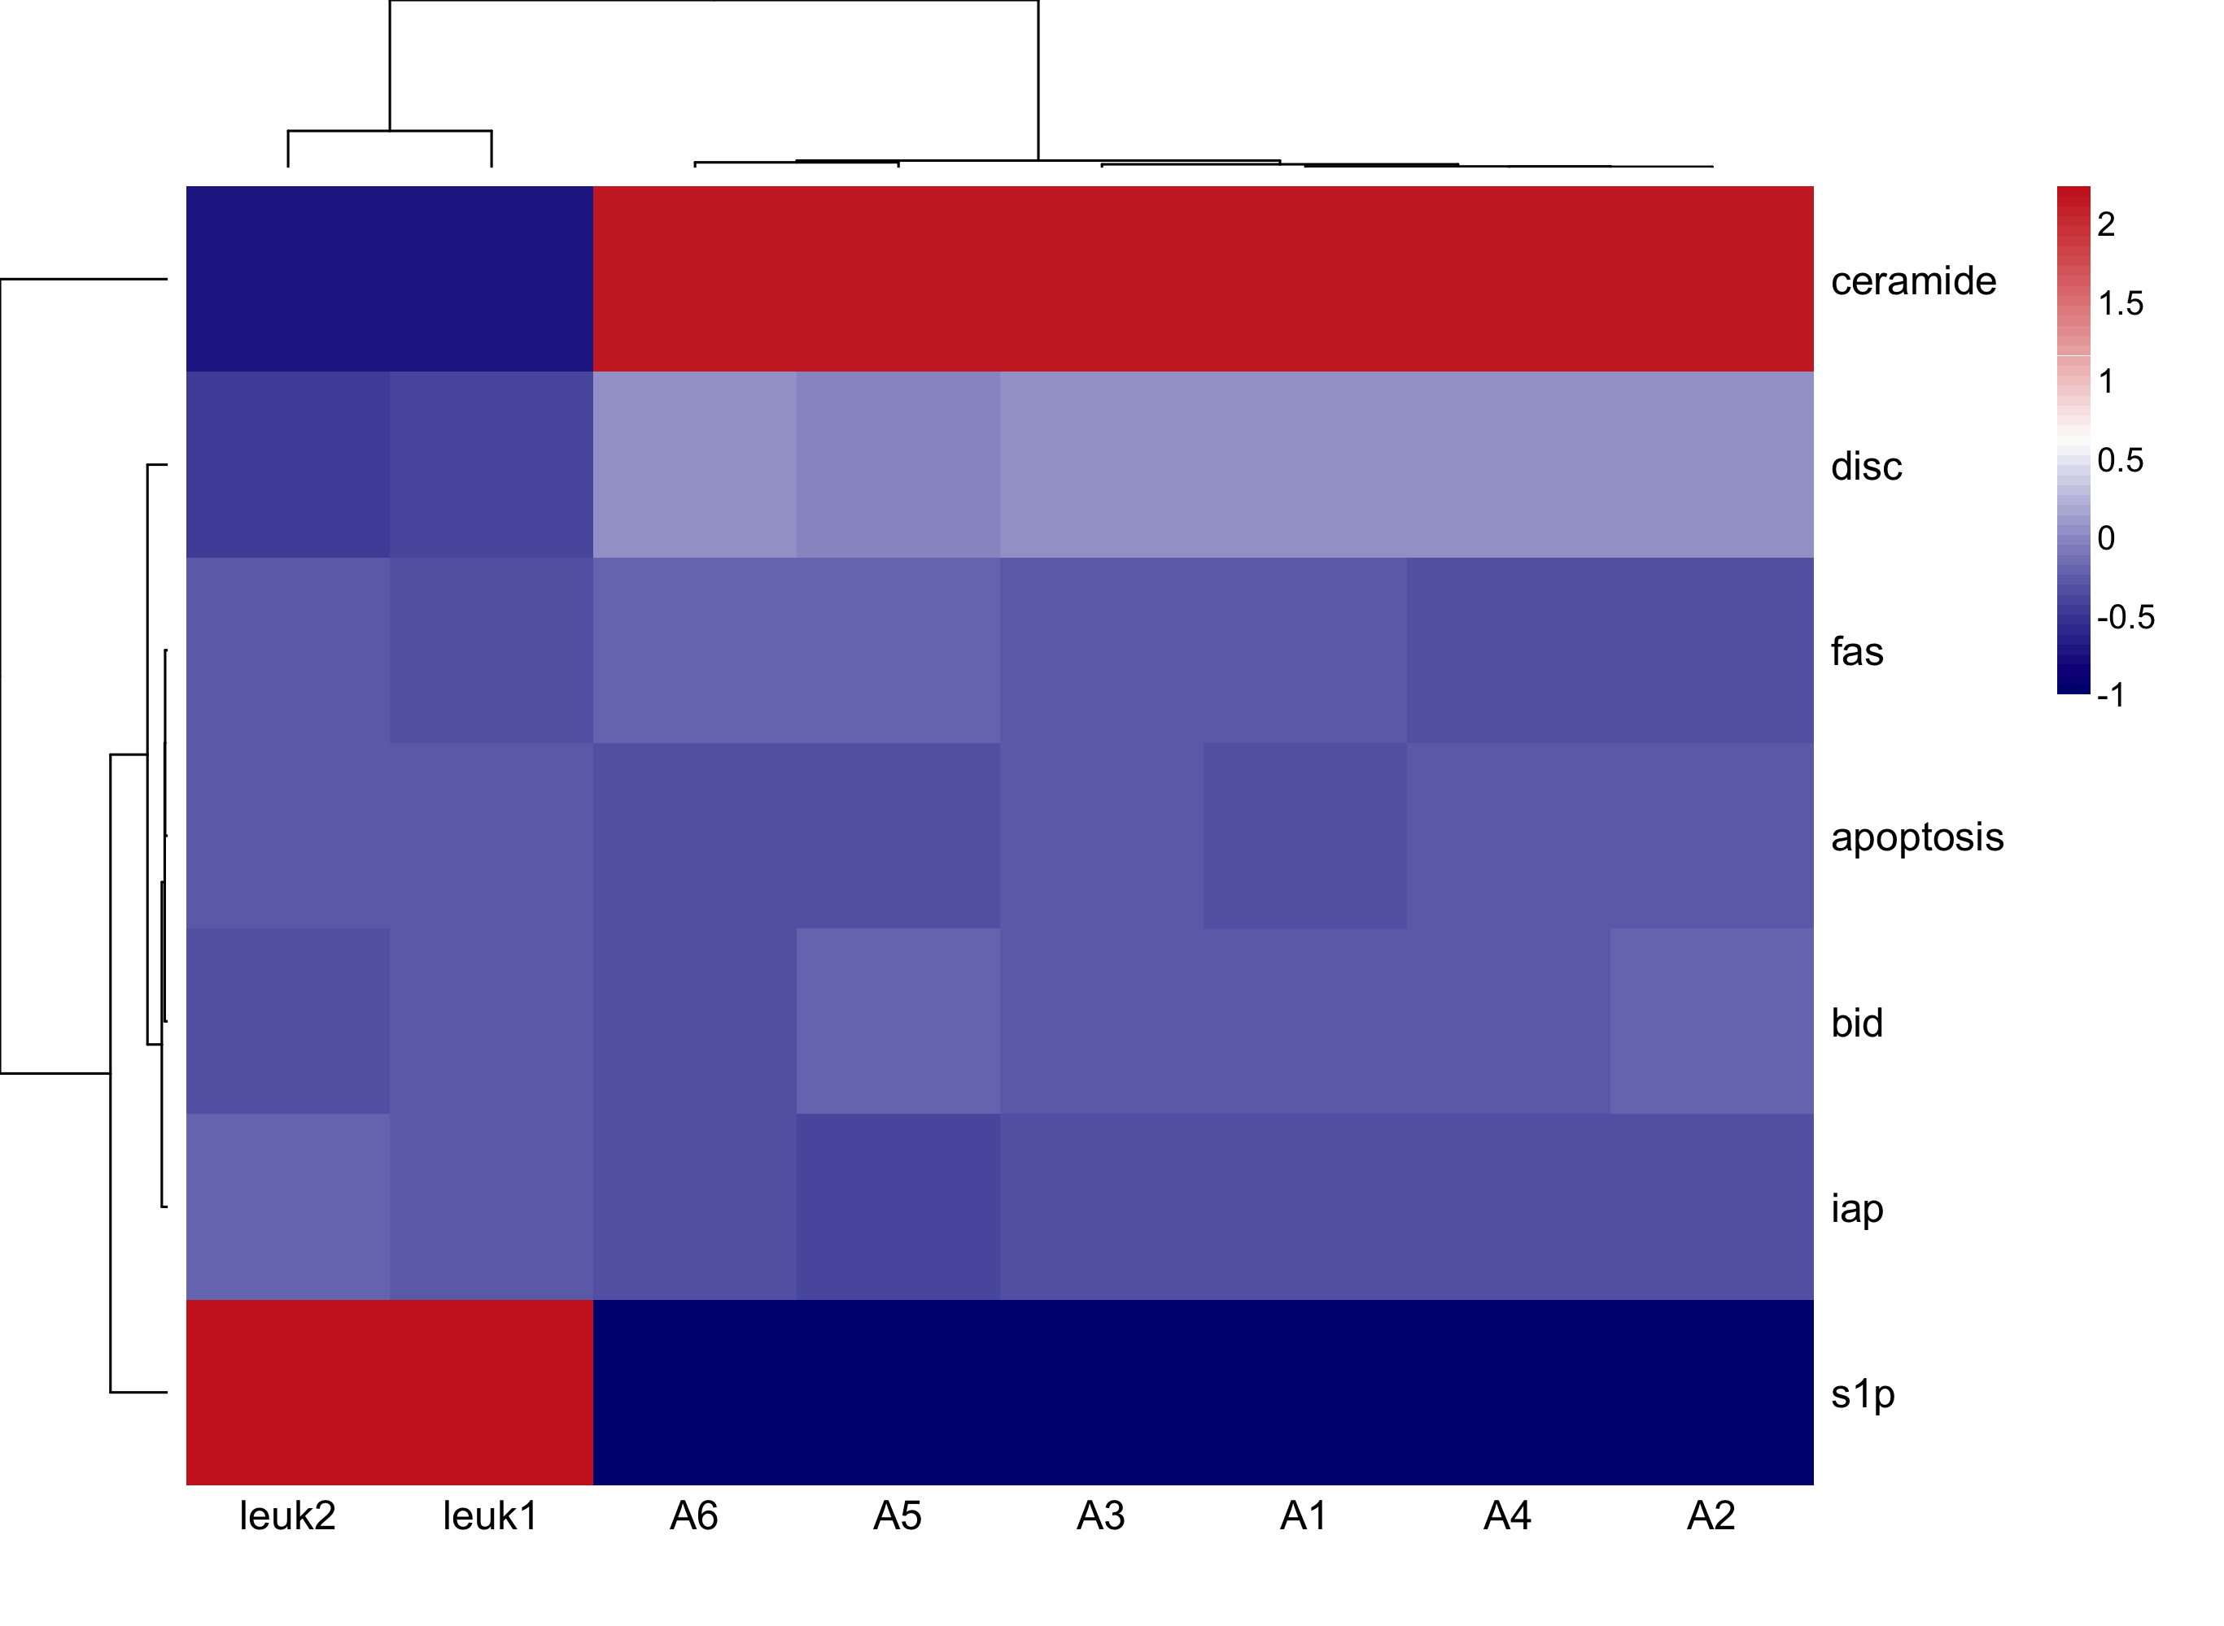

Slide 44
Percent Accuracy in DAC of RONs | Percent of Attractor Comparisons with That Accuracy
65.62 | 100
18.13 | 85.71
11.32 | 71.43
3.04 | 57.14
1.89 | 42.86

Slide 45
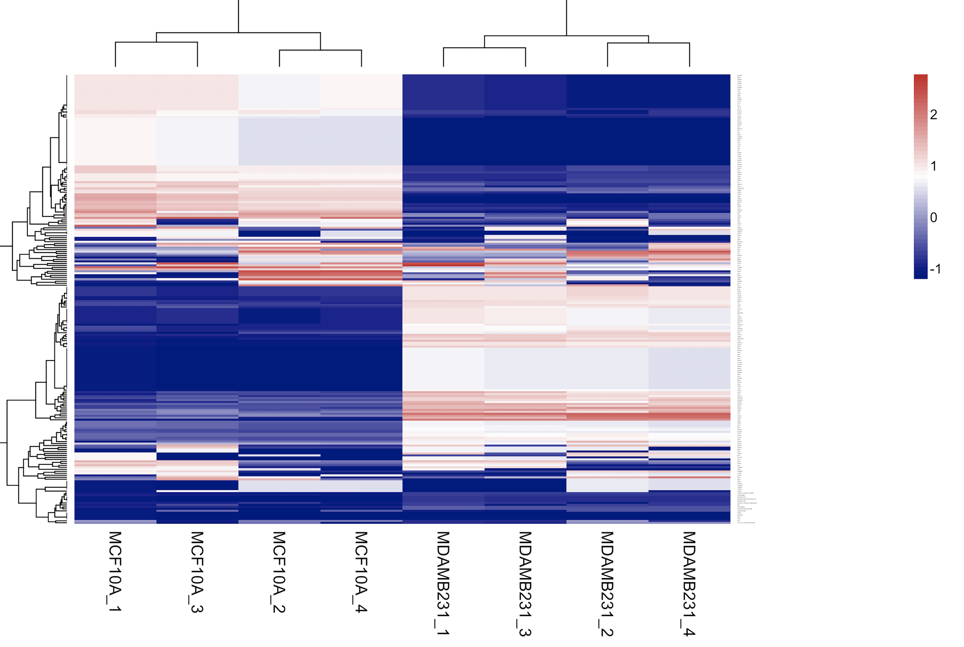
Interesting…
SFA results

Slide 46
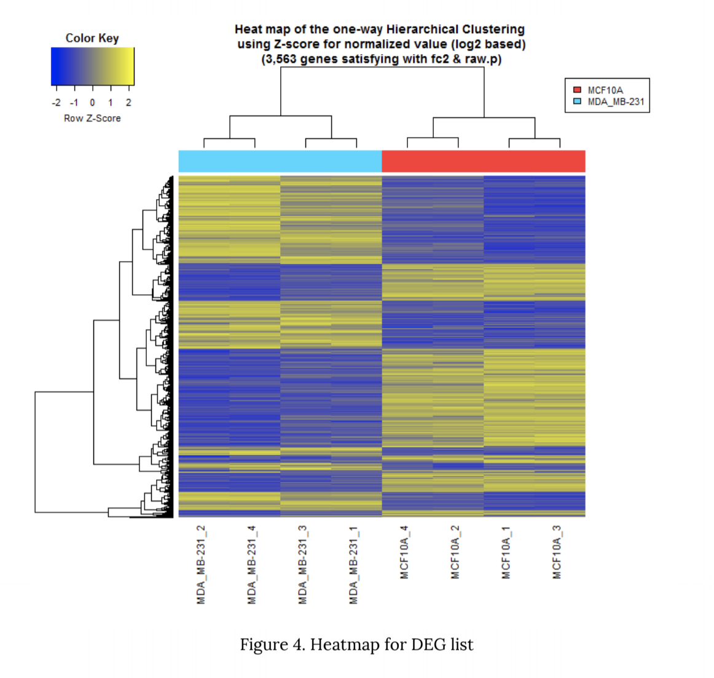
Macrogen report on RNAseq data

Slide 47
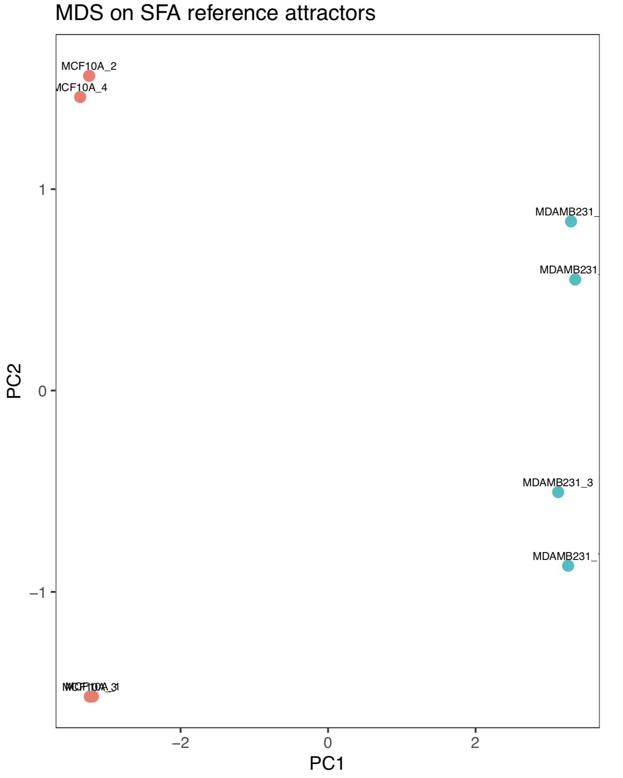
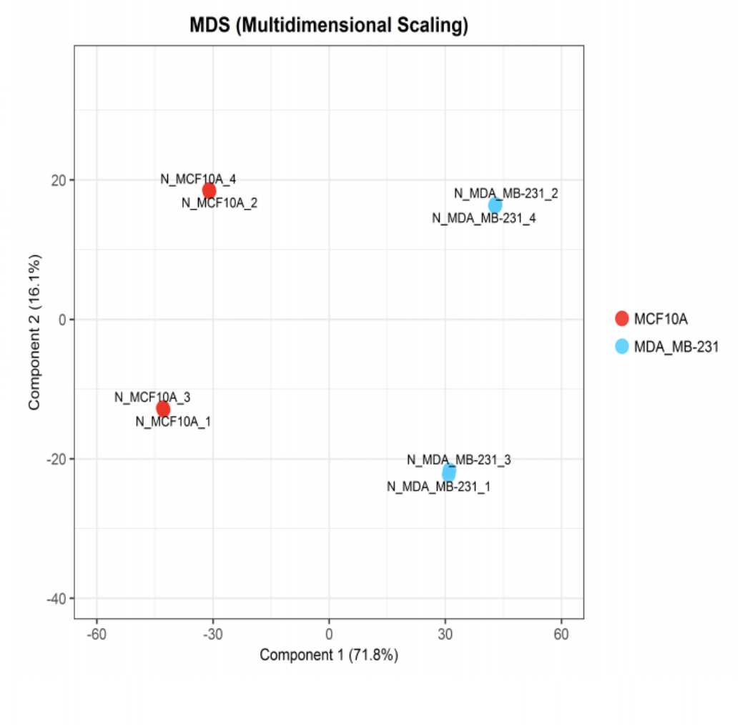
Macrogen report on RNAseq data

Slide 48
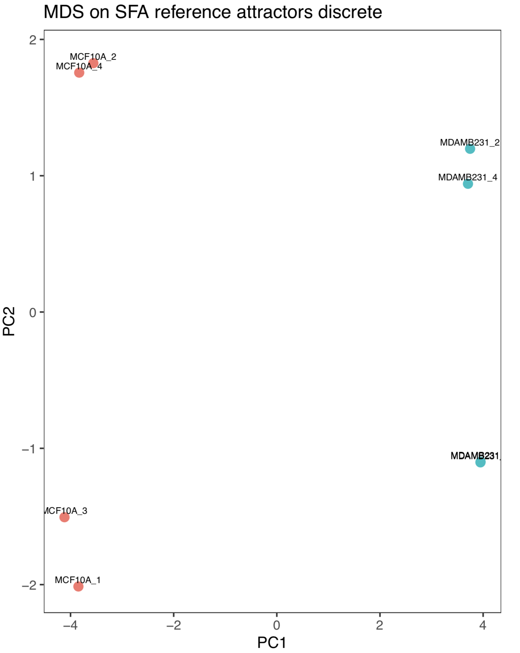

Slide 49
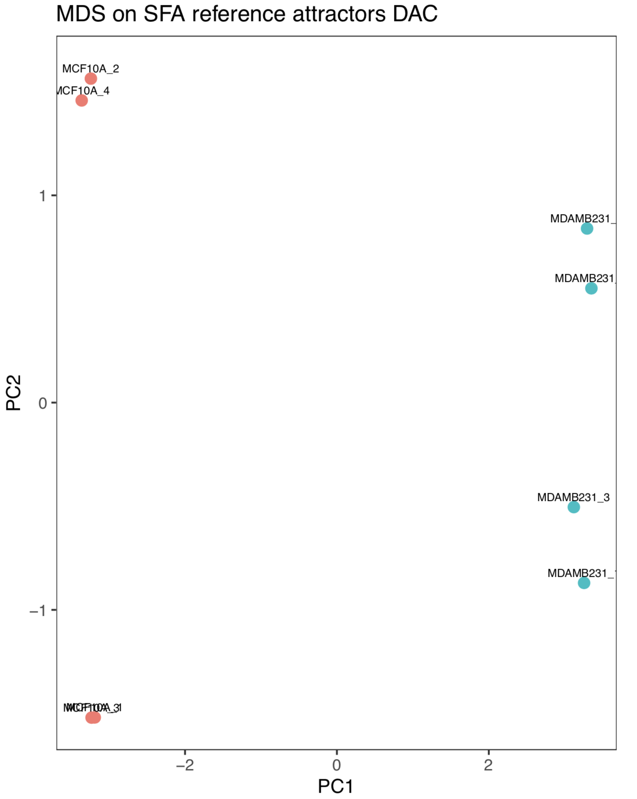
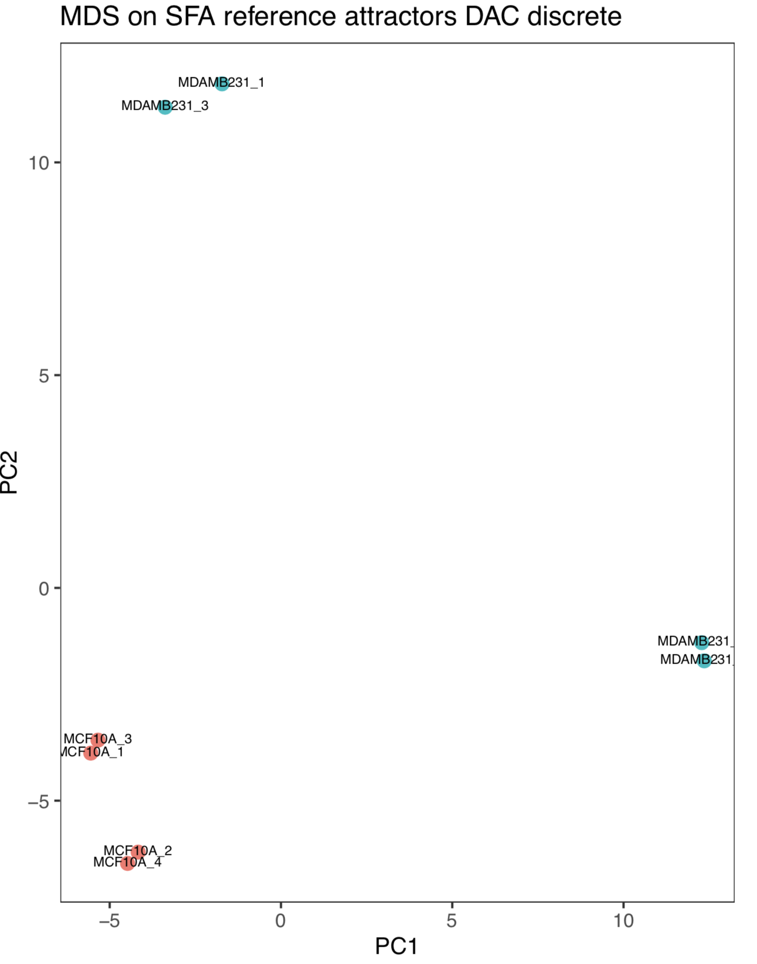

Slide 50
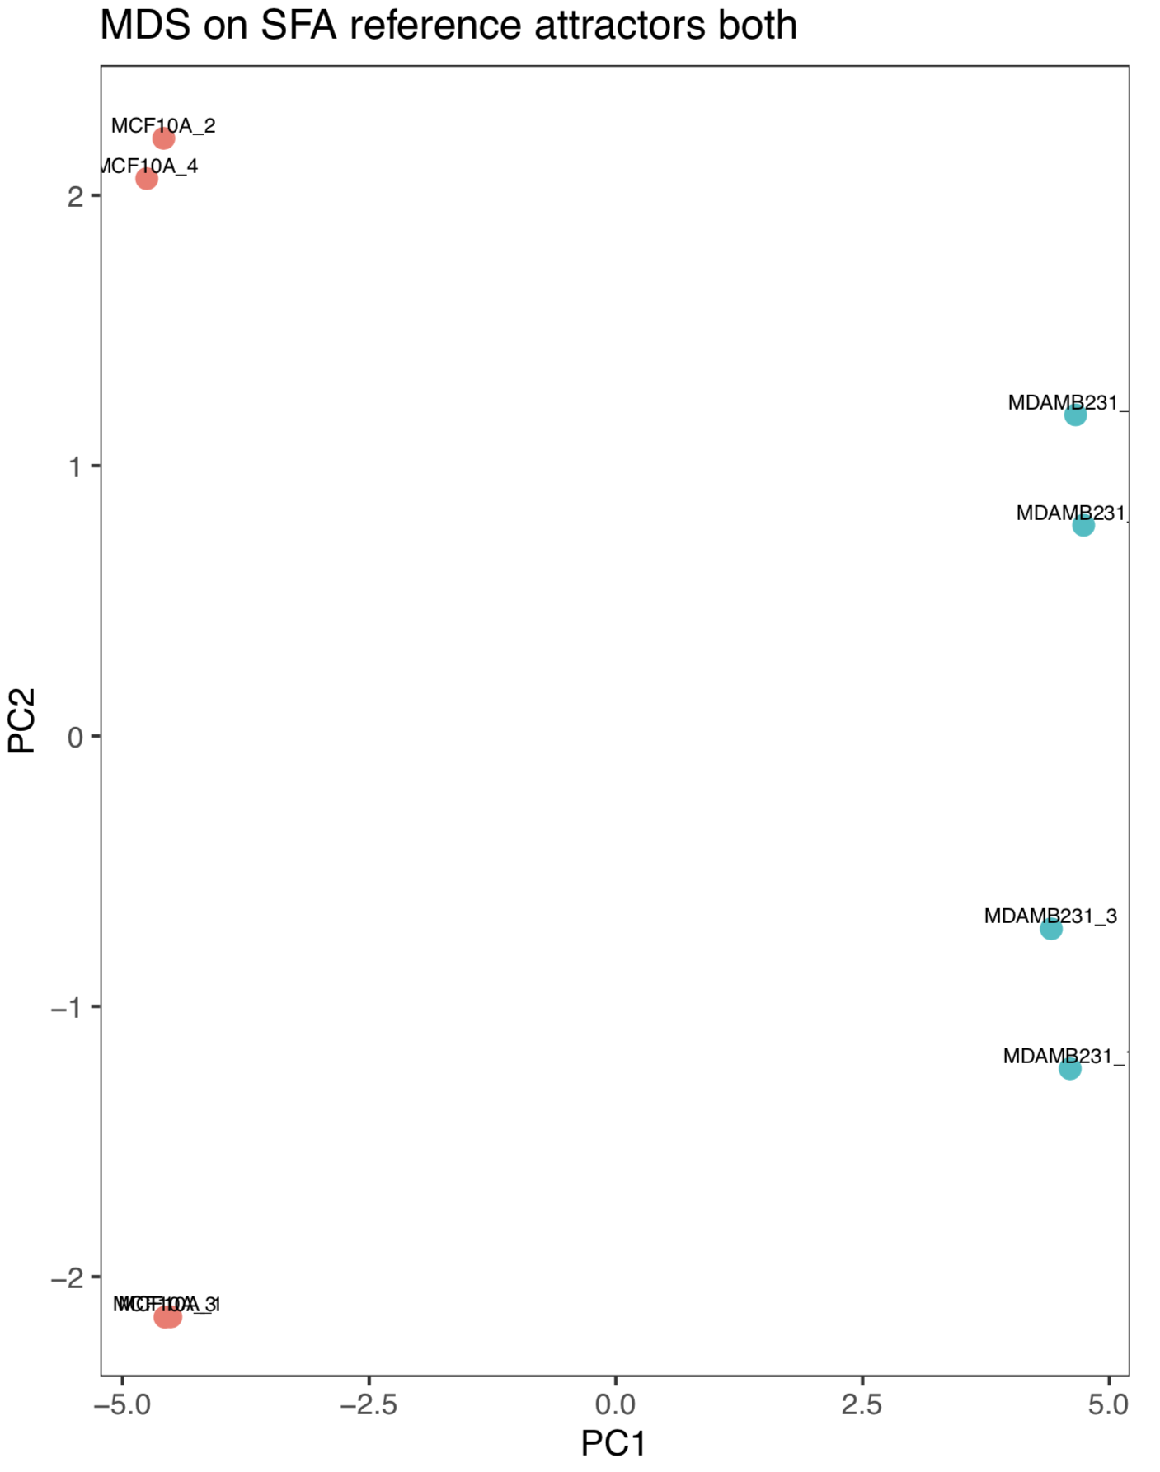
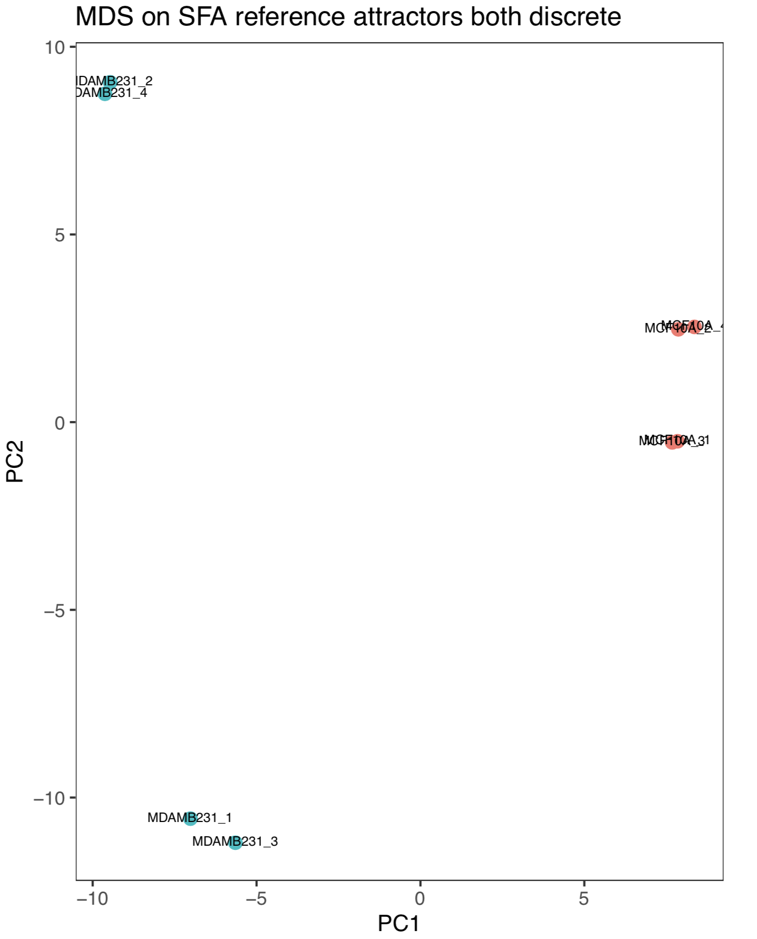

Slide 51
K-means on 8 experimental SFA attractors
Clustering on all the datasets separated the MCF10A and the MDA-MB-231 attractors EXCEPT for the discrete DAC.
When k = 2, some of thee MDA-MB-231 attractors clustered with the MCF10A attractors with kmeans on both the SFA attractors and the reduced dimensions.

Slide 52
Analysis of Clustering Methods on Boolnet Attractors

Slide 53
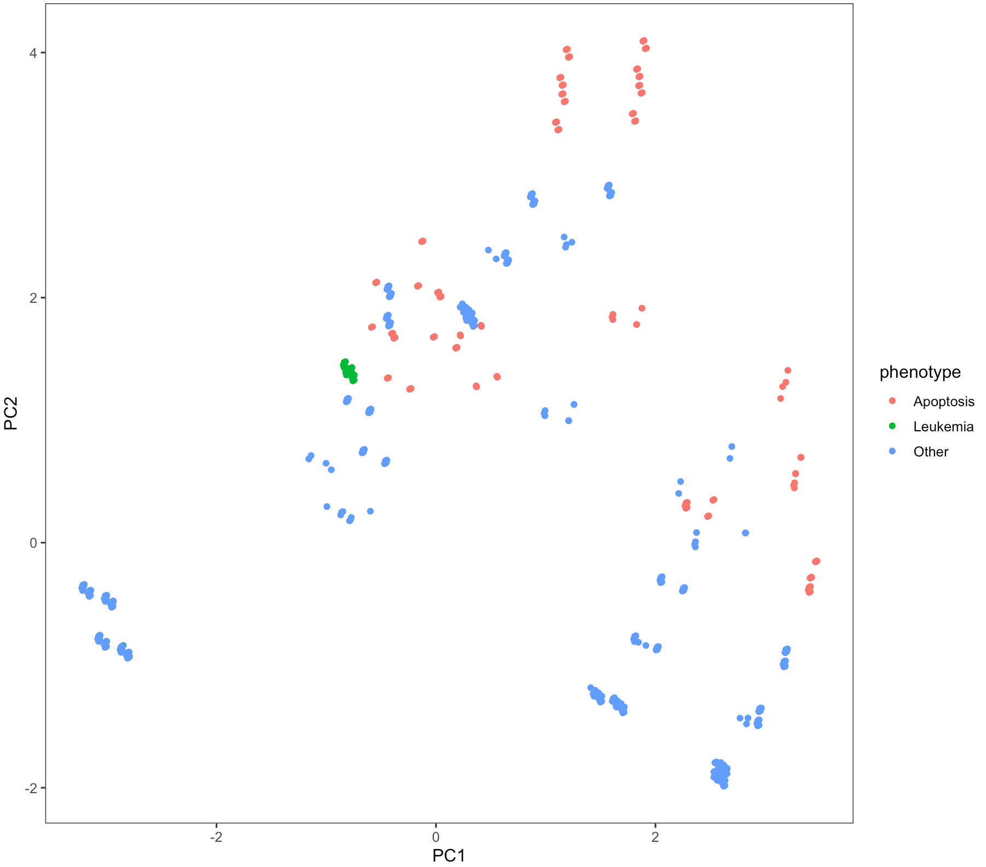
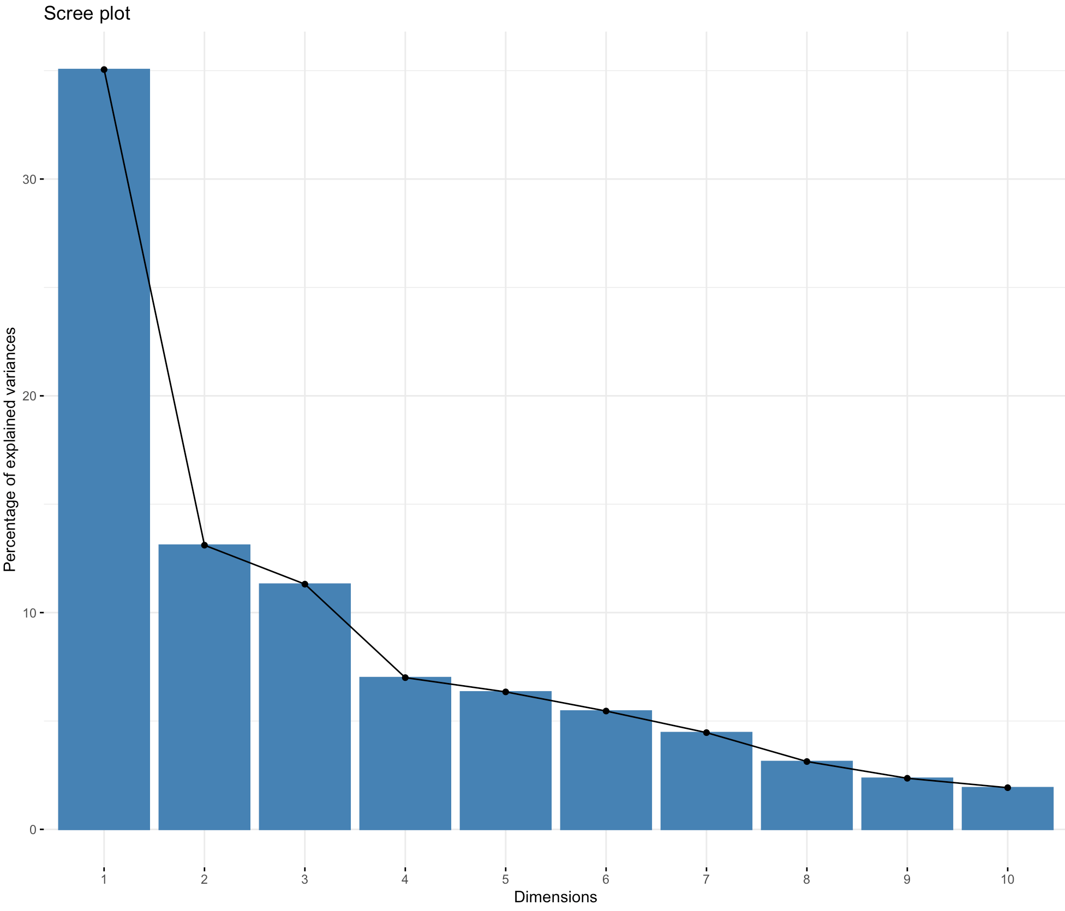
PCA on Boolnet Both

Slide 54
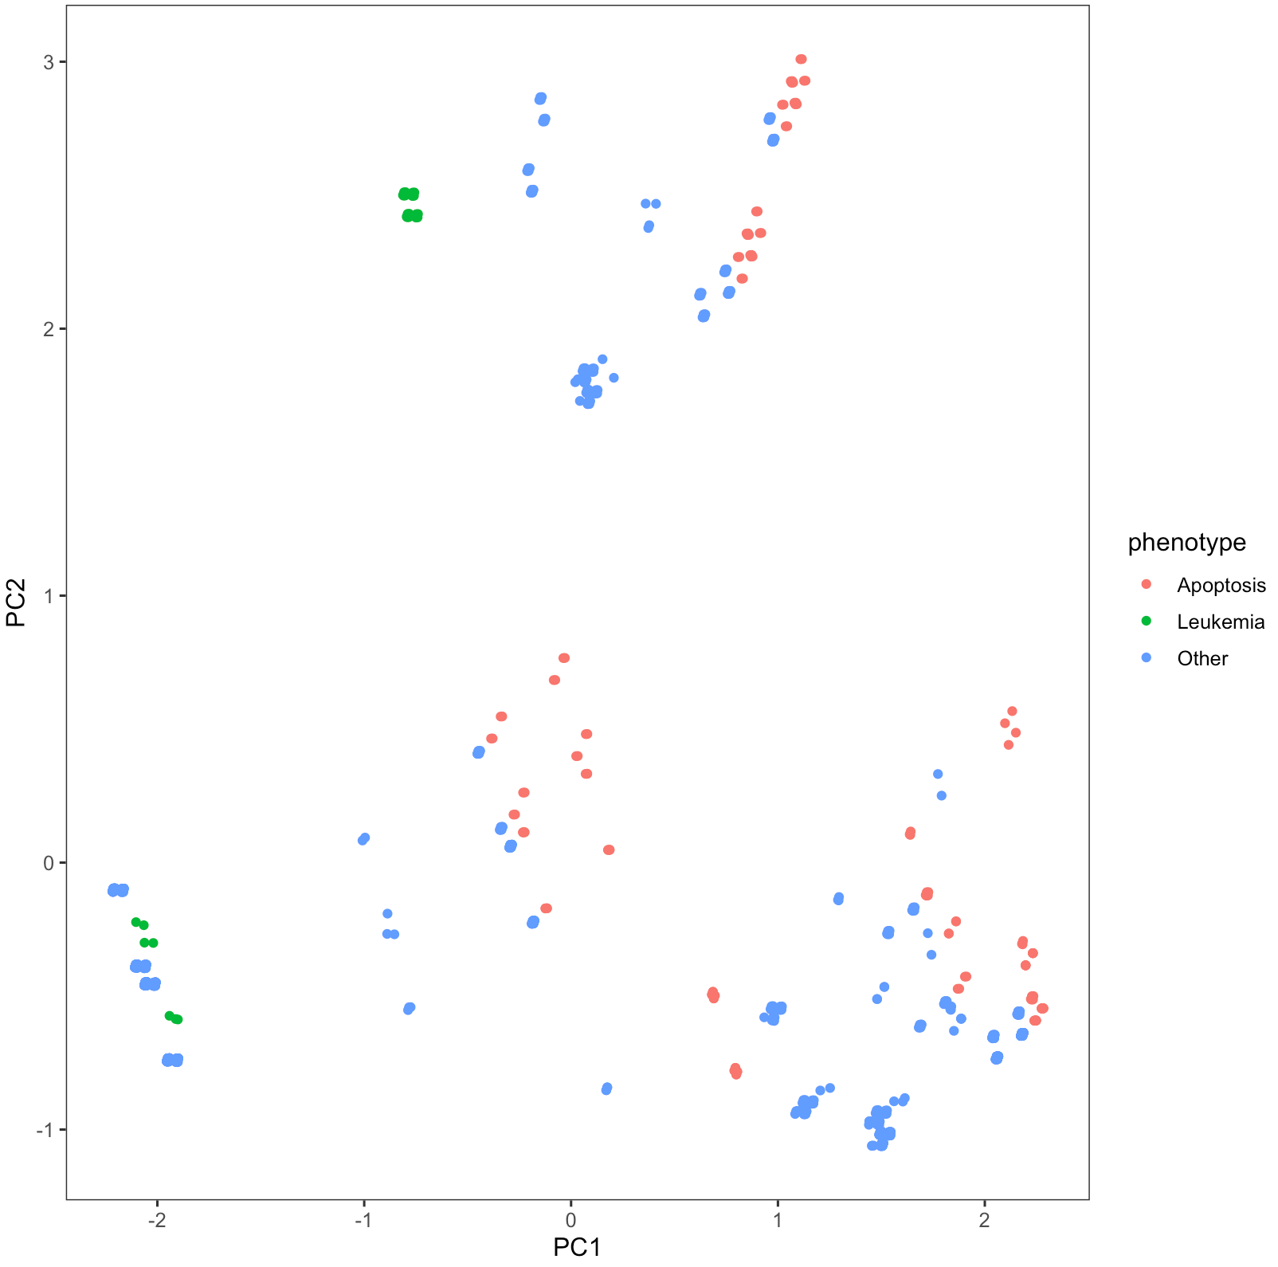

PCA on Boolnet Attractors

Slide 55


PCA on Boolnet DAC

Slide 56


Kmeans on PCA
Attractors
DAC

Slide 57

PCA on SFA
The first 2 components don’t account for enough variance!

Slide 58
Multi Dimensional Scaling
Looked at MDS with various distance metrics:
Euclidean
Manhattan
Hamming

Slide 59

Sammon Mapping
Type of nonlinear projection mapping
Hamming Distance
Boolean BOTH
(2n-tuples of attractor state and DAC)

Slide 60

MDS
Hamming Distance
Sammon Mapping
Boolean Attractor

Slide 61

MDS
Hamming Distance
Sammon Mapping
Boolean DAC

Slide 62

Stress
The first 2 components produce a stress ~0.1

Slide 63

Kmeans on Sammon Mapping with 2 Components
Notes:
K = 7 dataset =both
orange cluster is cluster 1. All of the nodes in that cluster have apoptosis ON
Orange, Pink and purple, aqua, cluster is all apop ON
Blue leukemia has 32 with apoptosis off, 12 with it oscilating
Green cluster (3) has 7 apoptosis off and 284 where it oscillates
Cluster 2 (brown) has 16 apop ON and 4 oscillating

Slide 64
Conclusion:
SFA can predict the effect of a perturbation on a network
When given random initializations, it does not perform well

Slide 65
To Do Next:
Finish Static Network Analysis
SFA with fixed nodes
Clustering with 8 SFA replicates?
Construct Boolean Network
Write draft of thesis
Methods section for Monday 3/23

Slide 66


Stress
Attr
Both
DAC

Slide 67



Kmeans on MDS
Attr
Both
DAC

Slide 68



Kmeans - Boolean
Attr
K = 10
(A = 7, L = 6)
Both
K = 13
(A = 6, L = 0)
DAC
K = 11
(A = 0, L = 6)

Slide 69



Kmeans – SFA
Attr
K = 10
(A = 5&6 ,L = 0)
Both
K = 12
(A = 2&9, L = 6)
DAC
K = 10

